Slide 1



12/2/21
Transition an Existing Implementation to Adobe Experience Manager as a Cloud Service
© 2021 Adobe. All Rights Reserved
1
© 2021 Adobe. All Rights Reserved 1 Adobe Digital Learning Services
Legal and Confidentiality Information
© 2021 Adobe, Inc. All rights reserved.
Every effort was made to ensure that the information in this document was complete and accurate at the time of printing. However, information is subject to change and Adobe cannot assume responsibility for any errors or omissions. Changes or corrections to the information contained in this document may be incorporated in future issues.
This copyrighted guide along with other materials for this course may not be recorded, reproduced, duplicated, reverse engineered or adapted.
Training is intended only for those individuals who have registered and paid for it; training access URLs, user names and passwords, or access of any kind may not be shared.
This document and other materials for this course are Adobe confidential and proprietary information which must be retained in confidence by the recipient.
2
© 2021 Adobe. All Rights Reserved
2
Adobe Digital Learning Services

Slide 2
12/2/21
Student Introductions
Please introduce yourself:
Name
Company and Role
Location
Adobe Experience Manager version
- On prem? Adobe Managed Services? AEM as a Cloud Service?
Level of AEM experience
Goals for this course
5
© 2021 Adobe. All Rights Reserved
5
Adobe Digital Learning Services
Course Checklist
Save course materials on your computer:
PowerPoint Slides (PDF)
Exercise Guide (PDF)
Exercise Files (zip file)
Use two monitors, if possible
Google Chrome browser is recommended
6
© 2021 Adobe. All Rights Reserved
6
Adobe Digital Learning Services

Slide 3
12/2/21
Course Agenda
Day 1
Introduction
Develop with Adobe Experience Manager Cloud Service
Introduction to Cloud Manager
Day 2
Deploy to Adobe Experience Manager as a Cloud Service
Moving to Adobe Experience Manager Cloud Service
* Timing is estimated
7
© 2021 Adobe. All Rights Reserved
7
Adobe Digital Learning Services
Introduction to Adobe Experience Manager as a Cloud Service
8
8

Slide 4
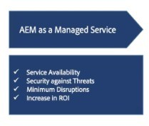
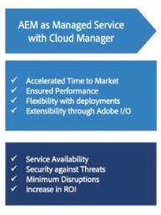
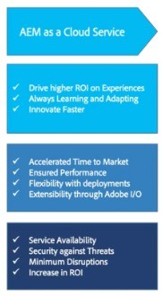


12/2/21
Valid Deployment Models
On-premises
Install Experience Manager on servers in your Corporate environment
Managed Services using Cloud Manager
Managed Services hosts Experience Manager in the cloud
Provides benefits of experience delivery solution in the cloud while retaining all the control, security and customization benefits of an on-premise deployment.
Experience Manager as a Cloud Service
Cloud-native way of leveraging the Experience Manager applications
Delivers content quickly and efficiently, leveraging a built-in Content Delivery Network (CDN)
Deep integration to the Adobe Experience Cloud
9
© 2021 Adobe. All Rights Reserved
9
Adobe Digital Learning Services
Evolution of Adobe Experience Manager
AEM on prem
AEM managed locally on prem
AEM hosted in the cloud
AEM hosted in the cloud, self-service
AEM as a cloud-native solution
10
© 2021 Adobe. All Rights Reserved
10
Adobe Digital Learning Services

Slide 5

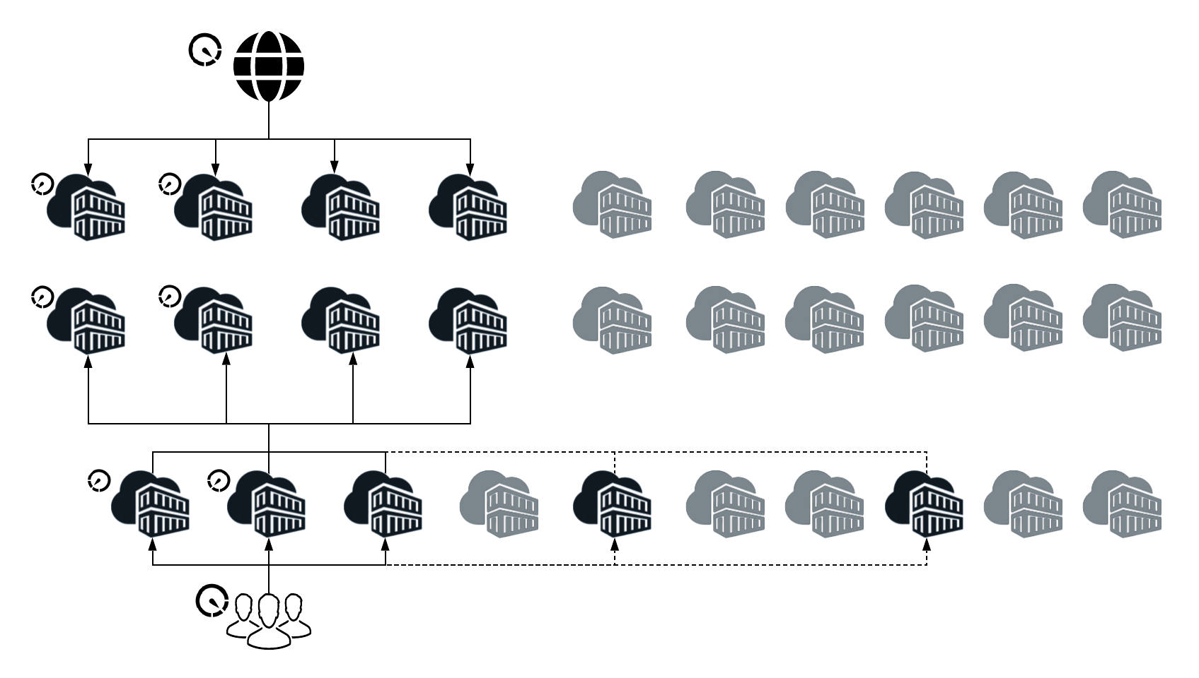
12/2/21
Adobe Experience Manager Release Schedule
Experience Manager on-premises and managed services product updates are delivered through quarterly service packs and Cumulative Fix Packs (CFPs)
Experience Manager as a Cloud Service
‘Push’ updates can be released as frequently as daily New feature updates follow a monthly release cadence
11
© 2021 Adobe. All Rights Reserved
11
Adobe Digital Learning Services
Adobe Experience Manager as a Cloud Service: What is it?
Cloud-native way of leveraging AEM applications
Digital foundation that’s always current, scalable, and accessible
Modular architecture designed to auto-scale within seconds
Preconfigured and tested to meet enterprise security best practices and industry-recognized certifications
Protected against outages and disasters with built- in redundancy and proactive monitoring
12
©¹2² 021 Adobe. All Rights Reserved
12
Adobe Digital Learning Services

Slide 6

12/2/21
Terminology
13
Adobe Experience Manager as a Cloud Service - Products
Product | Description
AEM as a Cloud Service | Cloud-native way of leveraging AEM applications
AEM Assets as a Cloud Service | Digital Asset Management (DAM), cloud-native, SaaS solution to ingest, process and manage digital assets
AEM Forms as a Cloud Service | Cloud-native solution to create, manage, publish, and update complex digital forms while integrating submitted data with back- end processes, business rules, and saving data in an external data store
AEM Sites as a Cloud Service | Instance of AEM as a Cloud Service with AEM Sites application
14
© 2021 Adobe. All Rights Reserved
1144
Adobe Digital Learning Services

Slide 7
12/2/21
Adobe Experience Manager as a Cloud Service – Deployment
Term | Description
Application | Set of customizations and configurations created by a customer (or their customizer) in order to adapt the underlying solution for their specific use cases and needs. For example, WKND
Organization | Adobe construct representing an Enterprise customer
Cloud Manager Program | Set of environments that support a logical grouping of customer initiatives
Cloud Manager Environment | Set of virtual machines, running AEM as a Cloud Service, within a program
Cloud Manager Pipeline | Set of deployment steps which are executed in sequence
15
© 2021 Adobe. All Rights Reserved
1155
Adobe Digital Learning Services
Adobe Experience Manager as a Cloud Service – Terminology
Term | Description
AEM Image | Deployable artifact that contains AEM product code and customer code
Artifact | Deployable result of some build process which transforms source code into a single unit. For example, a Zip file containing the source code
Cloud Manager Git Repository | Storage location for customer code and configuration settings
Cloud Provider | Support for Azure
Content Repository Service | Location for content persistence
16
© 2021 Adobe. All Rights Reserved
1166
Adobe Digital Learning Services

Slide 8
12/2/21
Adobe Experience Manager as a Cloud Service – Instances and Pipelines
Term | Description
Instance | Specific virtual server running the AEM solution All Instances in a tier represent a single logical unit from a deployment perspective.
AEM Author Tier | Authoring environment for Sites and Assets
AEM Preview Service | Mechanism to review a website’s final experience before it reaches the publish environment and is available publicly
AEM Publish Tier | Publishing environment for Sites
Adobe Pipeline | Mechanism for publishing content from Author to Publish
17
© 2021 Adobe. All Rights Reserved
1177
Adobe Digital Learning Services
Adobe Experience Manager as a Cloud Service – Terminology
Term | Description
Assets Microservices | Cloud-based digital asset processing services
Golden Master | Specialized publish node, never accessed by any end user, and from which all the nodes of the publish service are created
Orchestration Engine | Ensures that all author and publish services are scaling as and when needed
18
© 2021 Adobe. All Rights Reserved
1188
Adobe Digital Learning Services

Slide 9

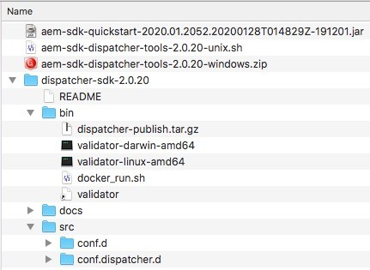

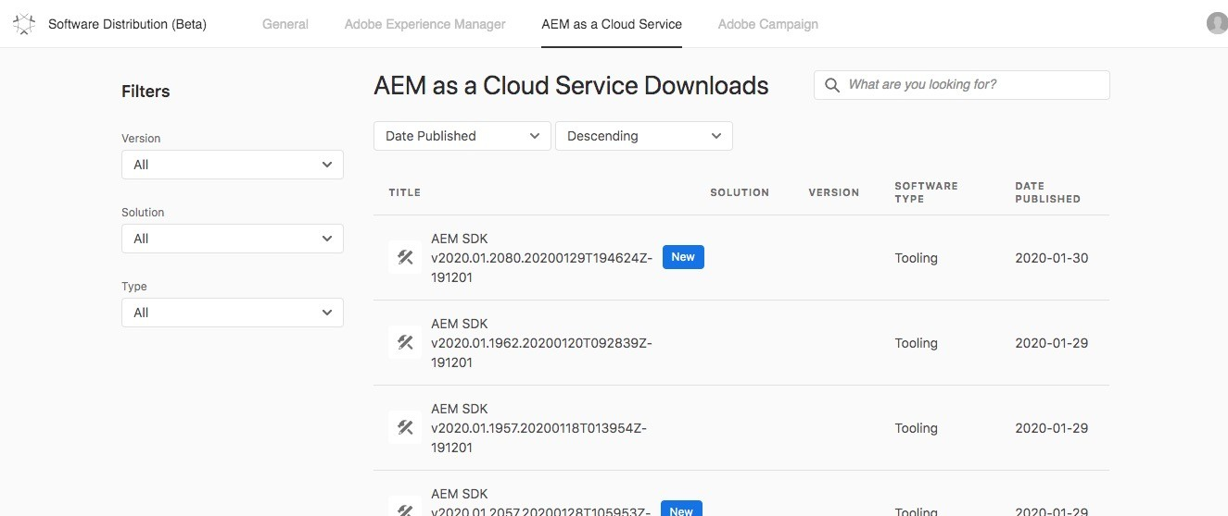



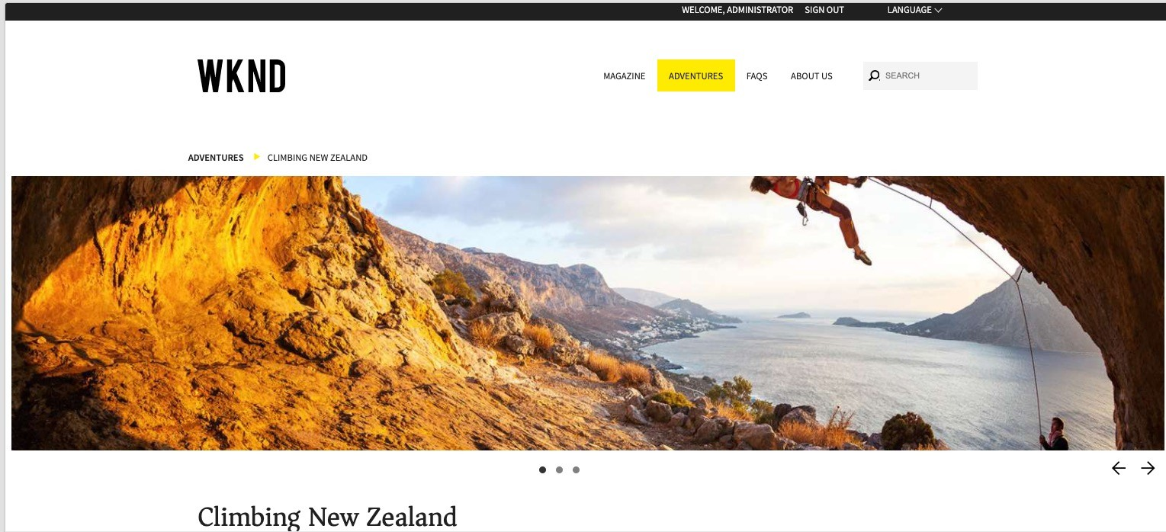
12/2/21
AEM Cloud Service SDK
Download from Experience Cloud distribution site What’s in it?
Cloud-ready quickstart jar
Dispatcher tools
AEM cloud-ready quickstart jar
Dispatcher tools
19
©¹⁹2021 Adobe. All Rights Reserved
19
Adobe Digital Learning Services
Adobe Experience Manager Reference Application
20
© 2021 Adobe. All Rights Reserved
2200
Adobe Digital Learning Services

Slide 10
12/2/21
Install AEM and the WKND reference application
The Experience Manager cloud-ready quickstart jar is the local instance of AEM that we will be using for development. Since AEM as a Cloud Service does not include sample content, we also have to install the WKND reference application. Exercise 1: Install Experience Manager cloud-ready quickstart jar Exercise 2: Install WKND Application
© 2021 Adobe. All Rights Reserved 21 Adobe Digital Learning Services
21
Experience Manager as a Cloud Service Architecture
22

Slide 11



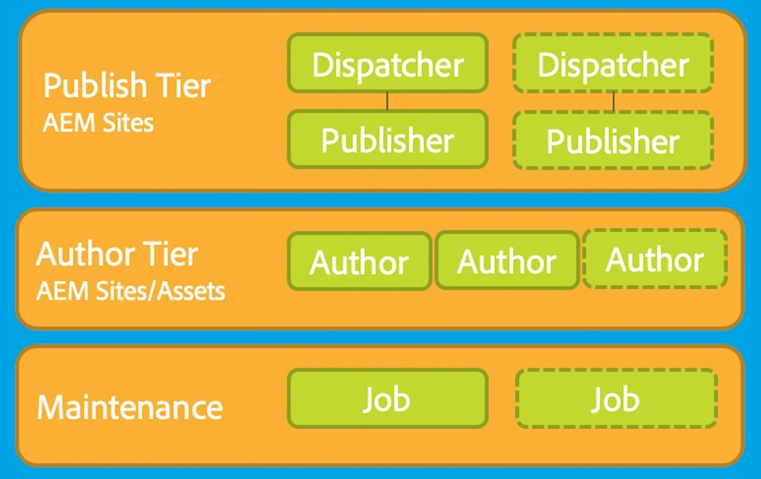

12/2/21
Adobe Experience Manager Cloud Service: Runtime Architecture
CDN Service
Per Environment
Shared Service Containers
Replication Service
CI/CD Service
Content Repository Service
Identity Management Service
Container Orchestration Service
Assets Compute Service
© 2021 Adobe. All Rights Reserved
23
Adobe Digital Learning Services
23
© 2021 Adobe. All Rights Reserved 23 Adobe Digital Learning Services
Adobe Experience Manager Sites runtime architecture
Each Environment has an author tier and a publish tier
Author tier is made of two or more nodes within a single author cluster.
Scales automatically, dependent on the authoring activity
Content authors/creators/producers login to the AEM author tier to create, edit, and manage content
Publish tier is comprised of two or more nodes within a single publish farm
Each node consists of an AEM publisher and a web server equipped with the AEM Dispatcher module. It scales automatically with site traffic needs.
End users, or site visitors, visit the website via the AEM Publish Service.
24
©²2⁴ 021 Adobe. All Rights Reserved
24
Adobe Digital Learning Services

Slide 12

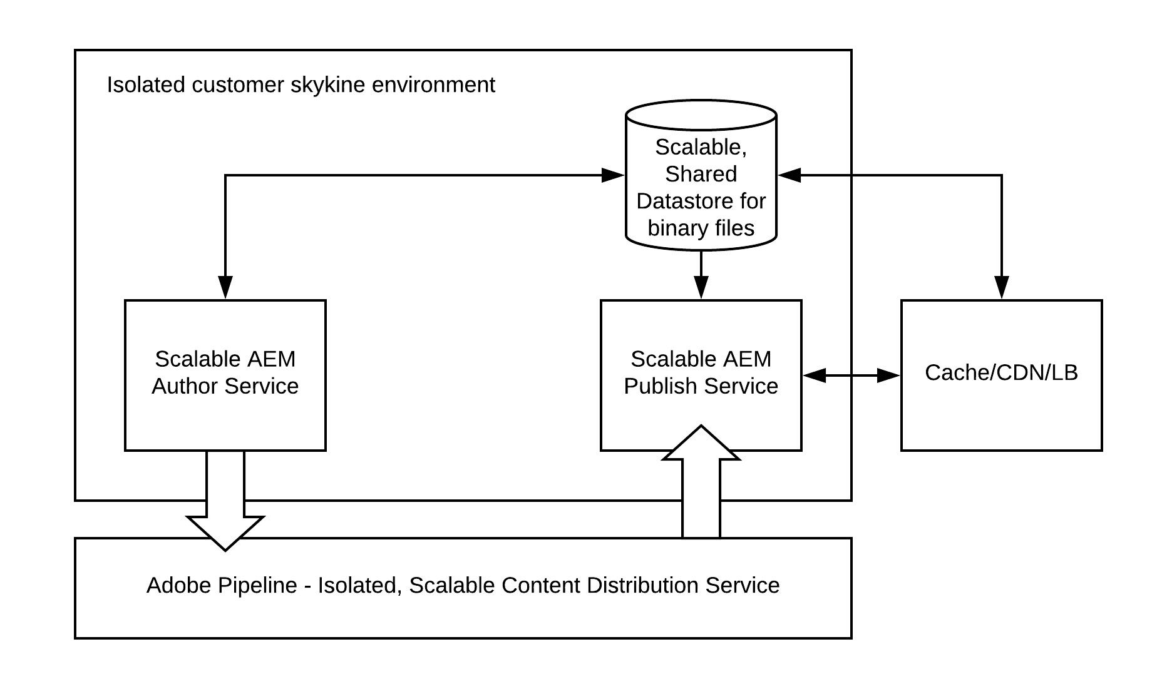
12/2/21
AEM Content Repository Service
Both the author tier and publish tier read and persist content from/to a Content Repository Service.
Publish tier only reads content from the persistence layer
Author tier reads and writes content from and to the persistence layer.
Blobs storage is shared across the publish and the author tier; files are not moved Content is published to the publish tier
Activation happens by way of the Adobe Pipeline which is implemented using Sling Content Distribution
Adobe Pipeline receives the new content, with the individual publish service nodes subscribing to the content pushed to the pipeline.
25
©²2⁵ 021 Adobe. All Rights Reserved
25
Adobe Digital Learning Services
Content Replication
Sling Content Distribution is used to move the content to a pipeline service run on Adobe I/O that is outside of the Experience Manager runtime:
Automated
Auto-configures itself during runtime when when publish nodes are added or removed
Un/Publication, to all publish instances, is atomic
26
©²2⁶ 021 Adobe. All Rights Reserved
26
Adobe Digital Learning Services

Slide 13

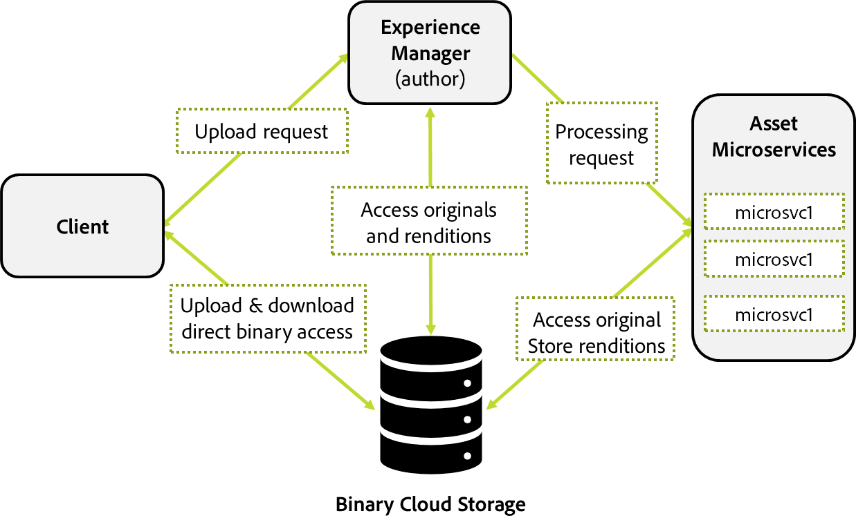
12/2/21
CDN Options
Adobe Managed CDN
Experience Manager's out-of-the-box CDN Point to Adobe Managed CDN
Customer points a CDN to Experience Manager's out-of-the-box CDN
27
©²2⁷ 021 Adobe. All Rights Reserved
27
Adobe Digital Learning Services
Cloud Asset Microservice
Serverless architecture Central binary store
Massive auto scalability for all Experience Manager services (author/publish/preview)
Instant publishing Fast uploads
Local CDN caching
28
©²2⁸ 021 Adobe. All Rights Reserved
28
Adobe Digital Learning Services

Slide 14

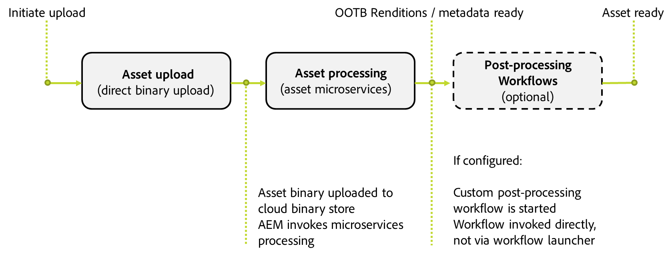
12/2/21
Benefits of Asset Microservices
Scalable architecture
Assets processing setup is managed and maintained by Adobe
Efficient indexing and text extractions that does not impact the performance of your Experience Manager environments
Minimize the need for workflows to handle asset processing in the Experience Manager environment
Ability to configure post-processing workflow to add user-specific actions and integrations. Improved resilience of asset processing
Native Adobe file processing services are used where applicable, providing high-fidelity output
29
© 2021 Adobe. All Rights Reserved
29
Adobe Digital Learning Services
Asset Processing and Ingestion
Asset are directly uploaded to the shared cloud binary storage Asset Microservices uses:
Standard Processing Profile
Custom Processing Profiles
Post-processing workflows (customizable)
30
©³2⁰ 021 Adobe. All Rights Reserved
30
Adobe Digital Learning Services

Slide 15
12/2/21
Key Takeaways
Adobe Experience Manager Cloud Service is the next generation of the AEM product line evolving into a cloud native solution
Adobe Experience Manager Cloud Service is updated as often as once a day with feature releases once a month
Cloud Manager is an essential component to Adobe Experience Manager Cloud Service and the only entry point for deploying AEM Cloud Service applications
The Adobe Experience Manager cloud-ready quickstart jar is deployed by way of the AEM SDK
31
© 2021 Adobe. All Rights Reserved
31
Adobe Digital Learning Services
Key Takeaways
Each Experience Manager as a Cloud Service environment has an author tier and a publish tier
Author tier: two or more nodes within a single author cluster
Publish tier: two or more nodes within a single publish farm Content is published by way of the Adobe Pipeline
Adobe Pipeline is implemented using Sling Content Distribution
Content publication uses a subscription model, where the publish nodes subscribe to the Pipeline Shared binary store offers
Direct binary upload/download
Improved Asset ingestion performance
Instant publishing
32
© 2021 Adobe. All Rights Reserved
32
Adobe Digital Learning Services

Slide 16
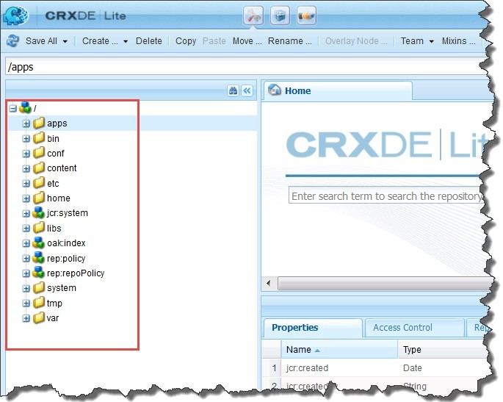
12/2/21
Develop with Adobe Experience Manager as a Cloud Service
33
Understanding the Repository Structure
/apps
/libs
/conf
/content
/etc
/oak:index
/home
/tmp
/var
34
©³2⁴ 021 Adobe. All Rights Reserved
34
Adobe Digital Learning Services

Slide 17

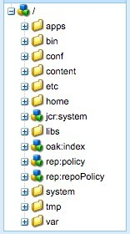
12/2/21
Separation of Application Content and Code/Configuration
Architecture mandates a complete
separation between
Application content
Application code and configuration
Customer application content
Customer application code
Customer application content
AEM UI and other appliation code
35
©³2⁵ 021 Adobe. All Rights Reserved
35
Adobe Digital Learning Services
Separation of Application Content and Code/Configuration
Code and configuration
Immutable
Built into the baseline image used to create the various nodes of the Author and Publish service tiers
mutable
immutable
As a result
Each node making up the service is identical
Changes to code and configuration can only be made globally by running a Cloud Manager pipeline
mutable
immutable
36
©³2⁶ 021 Adobe. All Rights Reserved
36
Adobe Digital Learning Services

Slide 18
12/2/21
Mutable versus Immutable Content
Experience Manager Code
/libs
Immutable Content
/apps
Cannot be changed (create, update, delete) after Experience Manager starts
Mutable content
/content, /conf, /var, /home, /etc, /oak:index, /system, /tmp …
Standard “default” content that is part of the customer project
37
©³2⁷ 021 Adobe. All Rights Reserved
37
Adobe Digital Learning Services
Maven AEM Project Archetype
38

Slide 19

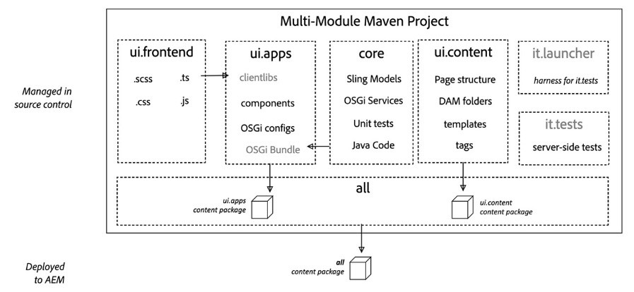
12/2/21
AEM Project Archetype
Strongly recommended for any Experience Manager project
Creates a minimal, best-practices-based Adobe Experience Manager project
Built in support for AEM as a Cloud Service
Built in SPA support
39
©³2⁹ 021 Adobe. All Rights Reserved
39
Adobe Digital Learning Services
AEM Project Archetype 30 Modules
all – container package
core – java bundle containing core functionality
dispatcher – dispatcher configuration
ui.apps –/apps and /etc
ui.apps.structure – repository roots into which project code deploys
ui.config – OSGi configuration definitions
ui.content – content using the components from ui.apps
ui.tests – java bundle containing Junit tests that are executed server-side
ui.launcher - glue code that deploys ui.tests
ui.frontend.general – optional artifacts required to use the general Webpack-based front-end build module ui.frontend.react - optional artifacts required when creating a SPA project based on React ui.frontend.angular – optional artifacts required when creating a SPA project based on Angular
40
©⁴2⁰ 021 Adobe. All Rights Reserved
40
Adobe Digital Learning Services

Slide 20

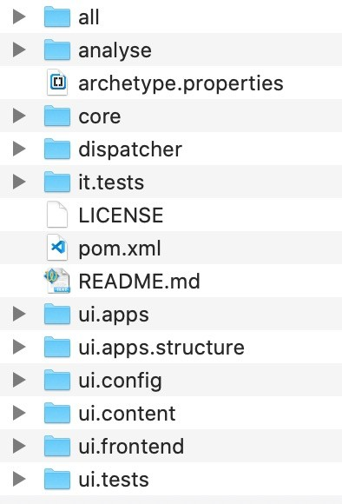

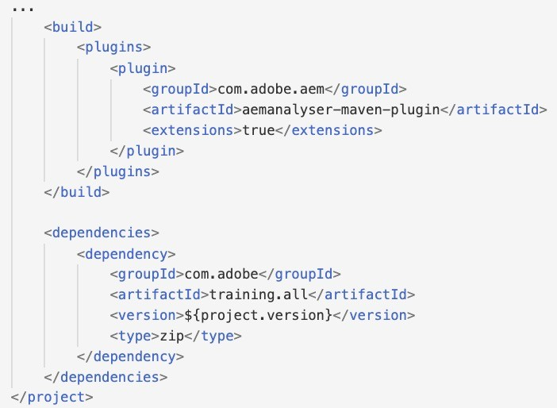
12/2/21
AEM Maven Project
deploy modules as a single artifact
application java code
dispatcher configuration
OSGi
configurations:
/apps/osgiconfig
integration tests bundles
application code:
/apps
application content:
/content, /conf
empty package defines the repository roots that code packages in this project deploy
client library files and resources
Generated from Maven AEM Project Archetype 25
41
© 2021 Adobe. All Rights Reserved
41
Adobe Digital Learning Services
analyse module
Runs analysis on the project, which provides additional validation for deploying into Adobe Experience Manager as a Cloud Service
AEM Maven Project now includes an analyzer maven plugin
Runs Feature Model Analysers on the content packages
Validates content packages before they are deployed to Adobe Experience Manager as a Cloud Service
42
©⁴2² 021 Adobe. All Rights Reserved
42
Adobe Digital Learning Services

Slide 21

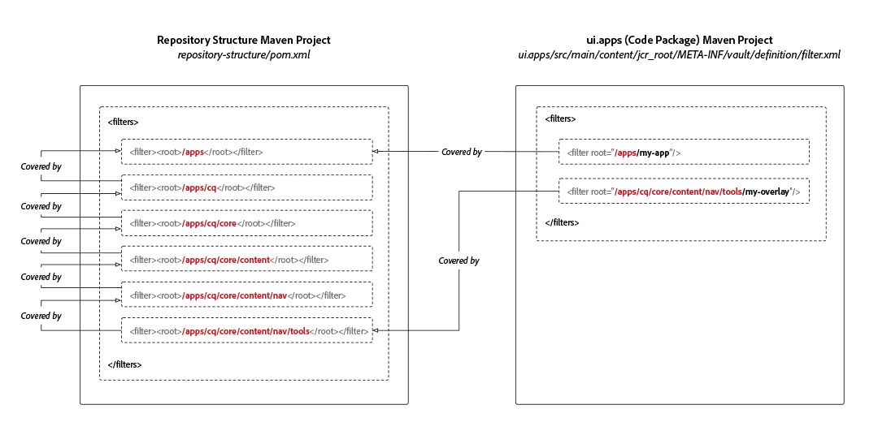
12/2/21
ui.apps.structure module
Required for Adobe Experience Manager as a Cloud Service maven projects Defines the JCR repository roots into which the project’s code sub-packages deploy
Ensures the installation of packages is automatically ordered by JCR resource dependencies
Missing dependencies may lead to scenarios where sub- structures would be installed ahead of their parent structures
43
©⁴2³ 021 Adobe. All Rights Reserved
43
Adobe Digital Learning Services
ui.config module and package
Deploys to /apps/my-app/osgiconfig
Applies to all AEM as a Cloud Service deployment targets Contains all OSGi Configurations, for example:
Runmode-specific OSGi configuration folders that contain OSGi configuration definitions that apply to all deployment targets
/apps/my-app/osgiconfig/config.<author|publish>.<dev|stage|prod>
repoinit OSGi configuration scripts used to define:
Baseline content structures
Users
Service Users
Groups
ACLs (permissions)
44
©⁴2⁴ 021 Adobe. All Rights Reserved
44
Adobe Digital Learning Services

Slide 22
12/2/21
ui.frontend module
Optional, dedicated front-end build mechanism based on Webpack Three options:
general - optional artifacts required to use the general Webpack-based front-end build module
react - optional artifacts required when creating a SPA project based on React
angular - optional artifacts required when creating a SPA project based on Angular
Note: requires NodeJs
45
©⁴2⁵ 021 Adobe. All Rights Reserved
45
Adobe Digital Learning Services
ui.frontend.general
Central location for front-end resources including JavaScript and CSS files
npm run dev script starts the front-end build process
full build with JS optimization disabled, source maps enabled and CSS optimization disabled
gathers the JavaScript and CSS files stored in the ui.frontend module
produces two minified client libraries or ClientLibs called clientlib-site and clientlib- dependencies
deposits them in the ui.apps module
Additional scripts:
npm run prod - full build with JS optimization enabled, source maps disabled and CSS optimization enabled
npm run start - Starts a static webpack development server for local development with minimal dependencies on Experience Manager
46
©⁴2⁶ 021 Adobe. All Rights Reserved
46
Adobe Digital Learning Services

Slide 23

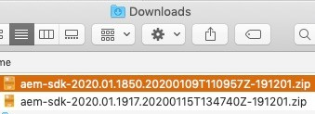

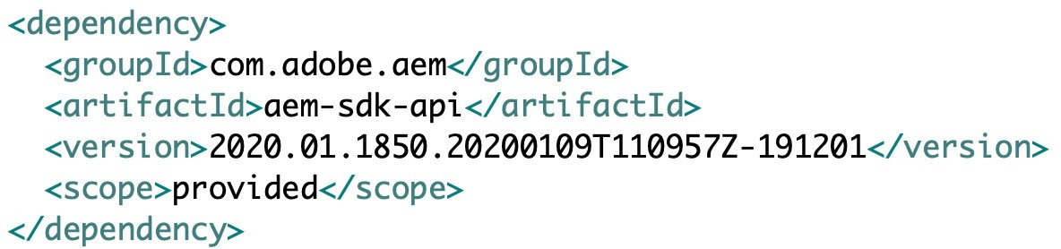

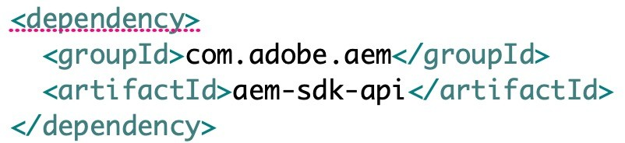
12/2/21
API Jar
Special JAR file provided by Adobe
Used to reduce the number of dependencies Contains:
All public Java APIs exposed by Experience Manager
Limited external libraries—all public APIs available in Experience Manager that comes from Apache Sling, Apache Jackrabbit, Apache Lucene, Google Guava, and two libraries used for image processing
Interfaces and classes exported by an OSGi bundle in AEM
MANIFEST.MF file with the correct package export versions for all the exported packages
Note: The API jar replaces the uber jar
47
©⁴2⁷ 021 Adobe. All Rights Reserved
47
Adobe Digital Learning Services
SDK API dependency in project pom.xml
Downloaded SDK from downloads.experiencecloud.adobe.com
Specify the same AEM version as downloaded in the AEM SDK
Maven Dependency element (parent)
Maven Dependency element (modules)
48
© 2021 Adobe. All Rights Reserved
48
Adobe Digital Learning Services

Slide 24

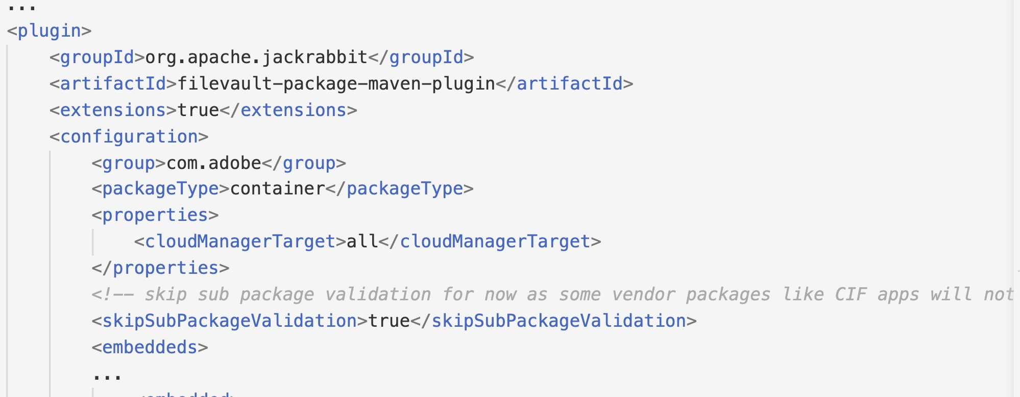
12/2/21
Application Deployments
Single package
Package should contain embedded sub-packages for code, configuration and any supporting baseline content
Separation of content and code
Single content package cannot deploy to both mutable and immutable content
Application must separate code and content into discrete packages for deployment into AEM
49
©⁴2⁹ 021 Adobe. All Rights Reserved
49
Adobe Digital Learning Services
Package Types
Container packages must set their packageType to container
Example: all package
Code (immutable) packages must set their packageType to application
Example: ui.apps package
Content (mutable) packages must set their packageType to content
Example: ui.content package
50
©⁵2⁰ 021 Adobe. All Rights Reserved
50
Adobe Digital Learning Services

Slide 25

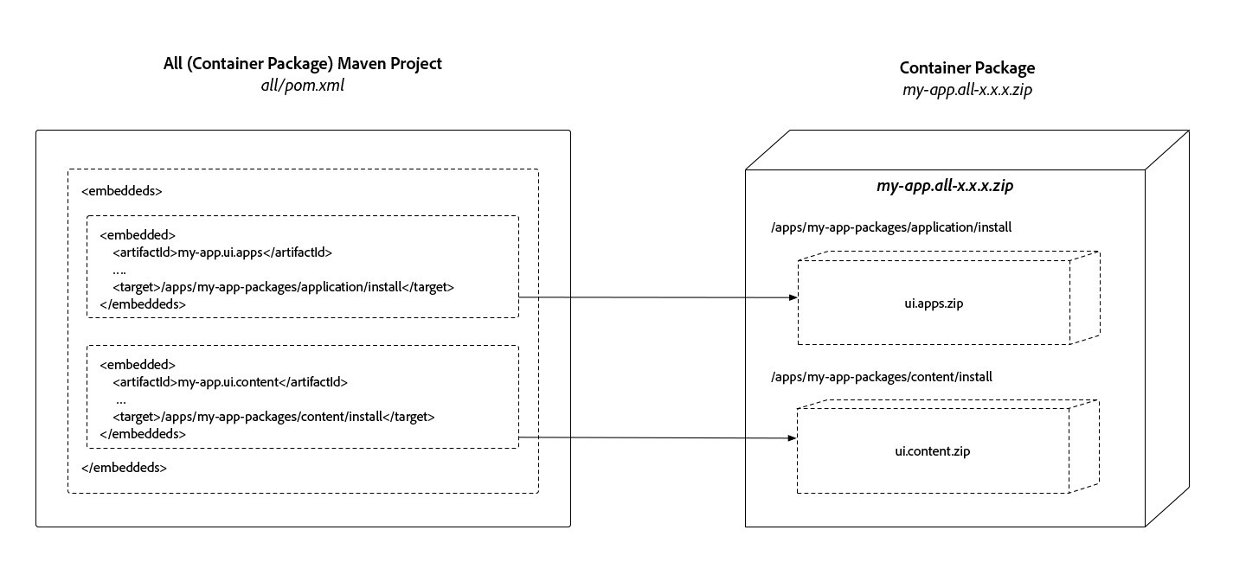

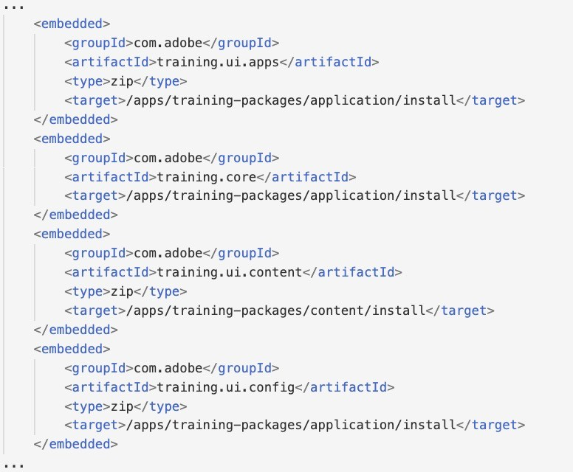
12/2/21
Embedding sub-packages in the all container package
Content or code packages can be targeted for installation on author, publish, or both
Use the filevault-package-maven-plugin <embeddeds> configuration
Note: <subPackages>
configuration should not be used
51
©⁵2¹ 021 Adobe. All Rights Reserved
51
Adobe Digital Learning Services
Project packages included as <embedded> packages
This example shows the training project packages included as <embedded> configurations in the all module pom.xml file filevault-package-maven-plugin definition
Deployment target locations in repository
Target format: /apps/<app-name>-packages/(content|application|container)/install(.author|.publish)
52
©⁵2² 021 Adobe. All Rights Reserved
52
Adobe Digital Learning Services

Slide 26

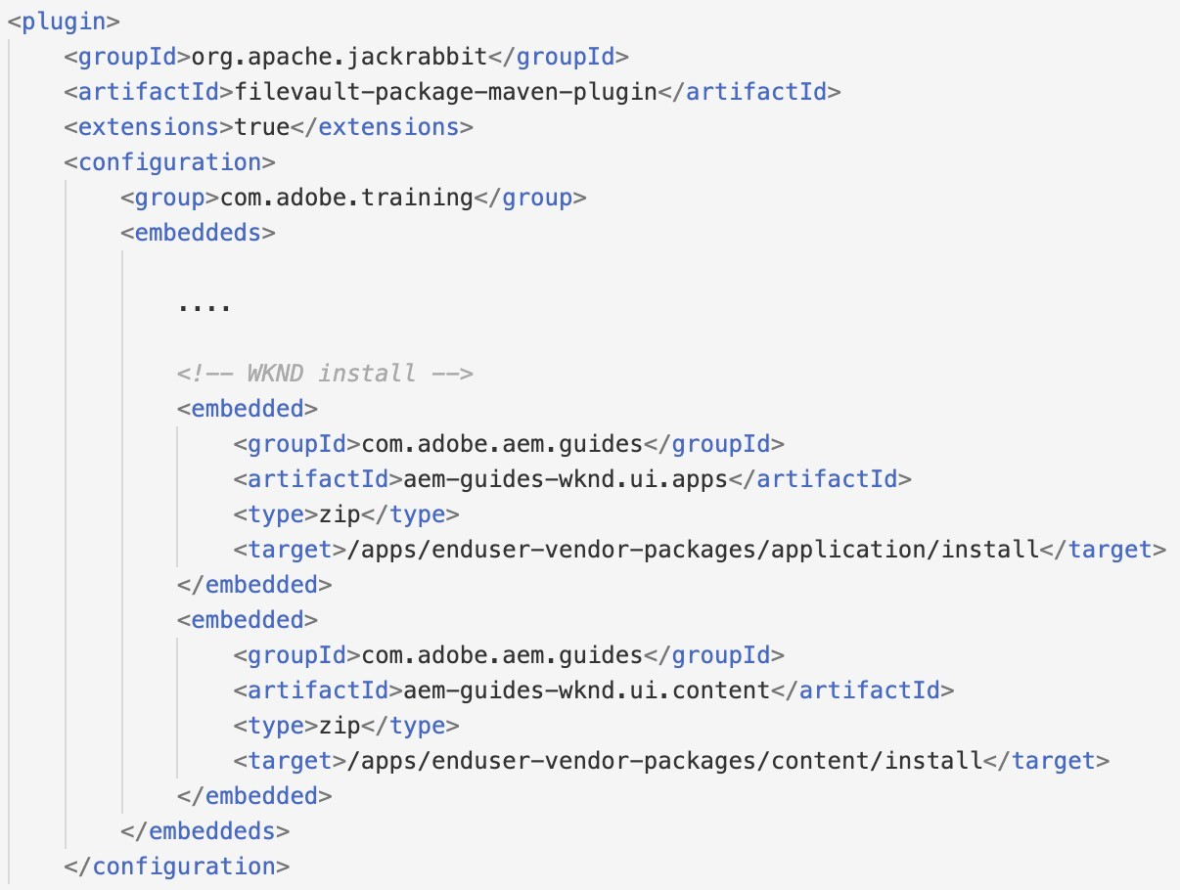

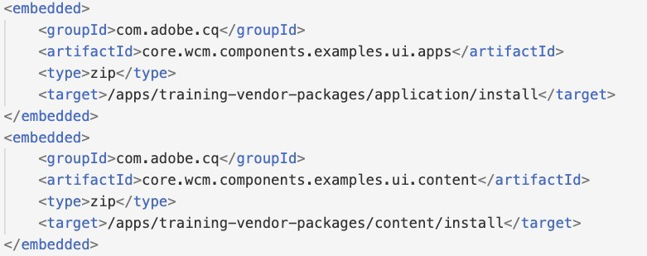
12/2/21
Including Third Party Packages
Best practice
Host packages in a remote repository
Reference them in the all/pom.xml
If that is not possible
Host in a local, file-system-based maven repository
Third party package must conform to Experience Manager coding and packaging guidelines
53
©⁵2³ 021 Adobe. All Rights Reserved
53
Adobe Digital Learning Services
Including third-party packages as <embedded> packages
Third-party packages must adhere to the AEM as a Cloud Service Service coding and packaging guidelines
Defined as <embedded> element in the all module pom.xml file
D_{Ta}e_{r}p_{g}l_{e}o_{t}y_{l}m_{oc}e_{a}n_{t}t_{io}ta_{n}rg_{in}et_{re}lo_{p}c_{o}a_{s}t_{i}i_{t}on_{ry}s in repository
Target format: /apps/<app-name>-vendor-packages/(content|application|container)/install(.author|.publish)
54
© 2021 Adobe. All Rights Reserved
54
Adobe Digital Learning Services

Slide 27
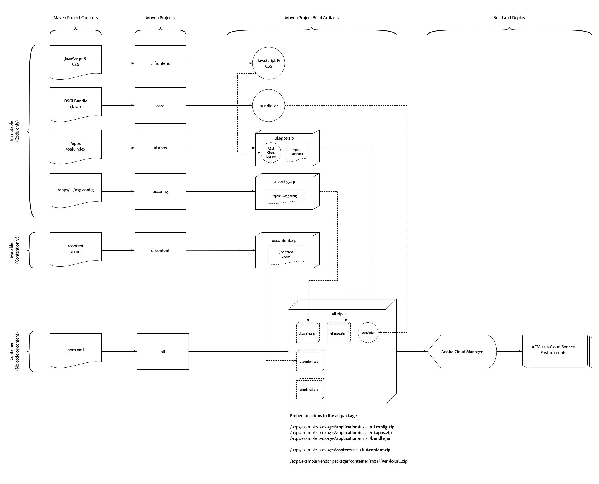
12/2/21
Recommended Package Structure
55
55
Generate an AEM project and deploy to Adobe Experience Manager
Best practices state that Experience Manager projects be created in the format generated by the Maven AEM Project Archetype. Exercise 1: Generate a project using the Maven AEM Project Archetype Exercise 2: Deploy Training Project to local Cloud-ready Instance
© 2021 Adobe. All Rights Reserved 56 Adobe Digital Learning Services
56

Slide 28
12/2/21
Local Development
57
Local Development - Introduction
Fundamentals of code development for AEM Cloud Service similar to previous models:
Developers checkout code from source control
Developers write code and test it locally
Developers push tested code to Company git branch
On a pre-defined schedule
Release candidate code pushed to Cloud Manager git repository
Cloud Manager git branch sent into the pipeline for remote Experience Manager Cloud environments
Cloud Manager is the sole mechanism for deploying code to Experience Manager Cloud environments
58
©⁵2⁸ 021 Adobe. All Rights Reserved
58
Adobe Digital Learning Services

Slide 29
12/2/21
Quirks of Local Development
AEM cloud-ready Quickstart uses Replication, not Content Distribution
Classic replication capabilities needs to be used with an Author/Publish setup
Publication mechanism is backwards compatible with the Replication Java APIs
Cloud Service publish problems cannot be tested on a local cloud-ready instance
Dispatcher tools provide mechanisms to test dispatcher configuration
Local test of dispatcher make use of Docker, therefore you cannot test access to an Experience Manager instance through the dispatcher on a virtual image
59
©⁵2⁹ 021 Adobe. All Rights Reserved
59
Adobe Digital Learning Services
Developer Tools and Environments
Capability | Local | AEM as a Cloud Service
 | AEM SDK Quickstart | Dev author | Dev publish | Stage author | Stage publish | Prod author | Prod publish
Local admin user | Yes | No | No | No | No | No | No
CRXDE Lite | Yes | Yes - limited | NA | No | No | No | No
Publishing Author > Publish | Classic UI Replicatio n Agents Manual | Distributio n Agents auto- configured | No | Distribution Agents auto- configured | No | Distribution Agents auto- configured | No
Package Manager UI | Yes | Yes – mutable content only | NA | Yes – mutable content only | NA | Yes – mutable content only
Asset Processing | DAM Update Workflow | Asset Compute | None | Asset Compute | None | Asset Compute | None
60
© 2021 Adobe. All Rights Reserved
60
Adobe Digital Learning Services

Slide 30

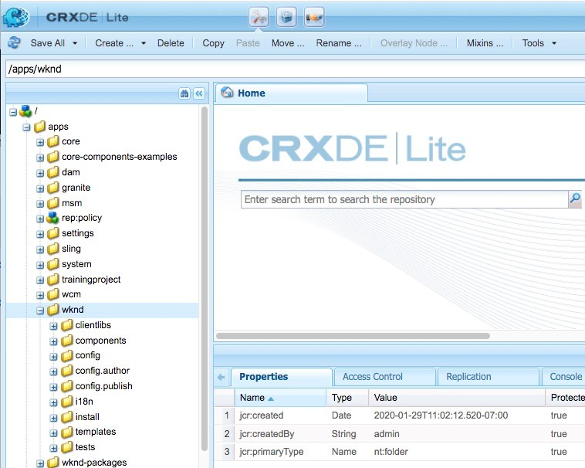

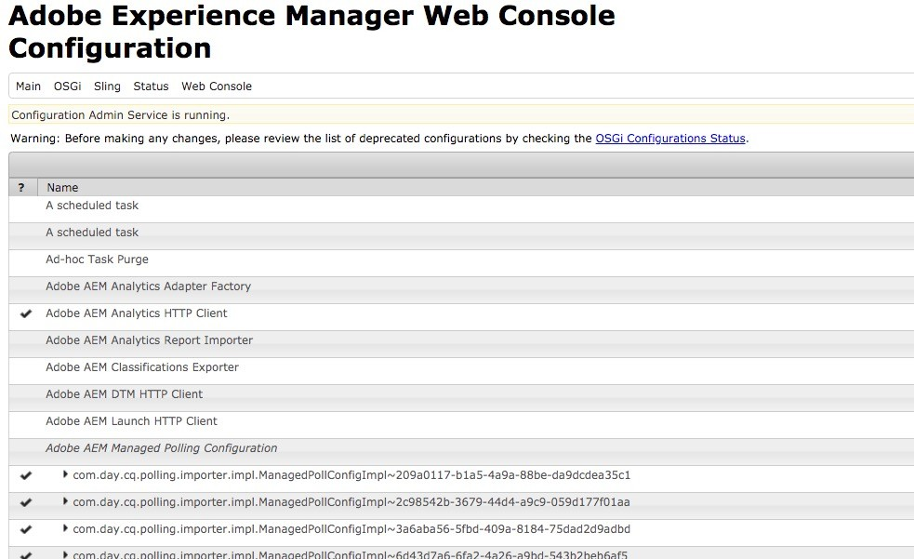

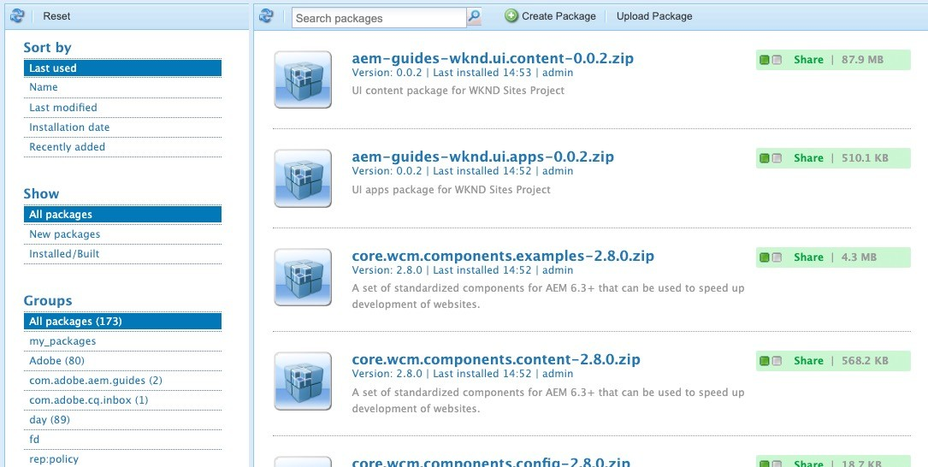
12/2/21
Developer Tools and Environments(cont)
Capability | Local | AEM as a Cloud Service
 | AEM SDK Quickstart | Dev author | Dev publish | Stage author | Stage publish | Prod author | Prod publish
i18n dictionary translation UI | Yes (author) | No | N/A | No | N/A | No | N/A
Page Editor Developer Mode | Yes (author) | No | N/A | No | N/A | No | N/A
Create custom rollout configs | Yes (author) | No | N/A | No | N/A | No | N/A
SSL Configuration | Manual through UI | Auto- configured | Auto- configured | Auto- configured | Auto- configured | Auto- configured | Auto- configured
61
© 2021 Adobe. All Rights Reserved
61
Adobe Digital Learning Services
CRXDE Lite, Package Manager, and System Console
Local development:
Developers have full access to CRXDE Lite, Package Manager and the Web Console
Cloud Service Development environment:
Developers can access CRXDE Lite (/apps and /libs remain immutable at runtime)
Developers have limited access to the Package Manager on author nodes
Debugging tools are available through the Developer Console
Cloud Service Production and Stage environments
Debugging tools are available through the Developer Console
Developers have limited access to the Package Manager on author nodes
No access to developer tooling
62
©⁶2² 021 Adobe. All Rights Reserved
62
Adobe Digital Learning Services

Slide 31

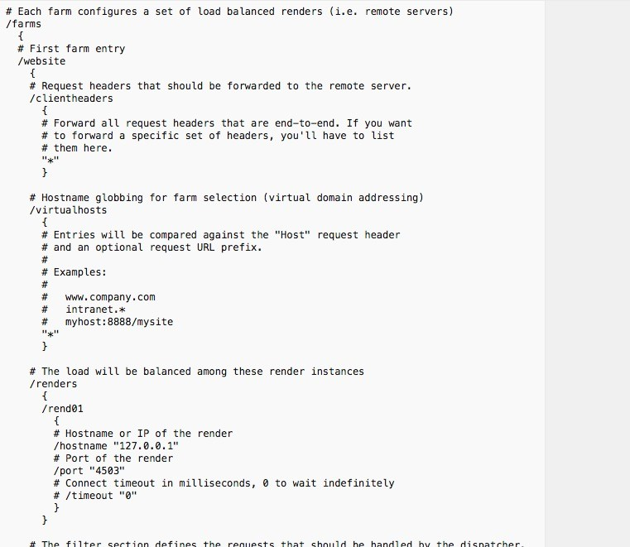

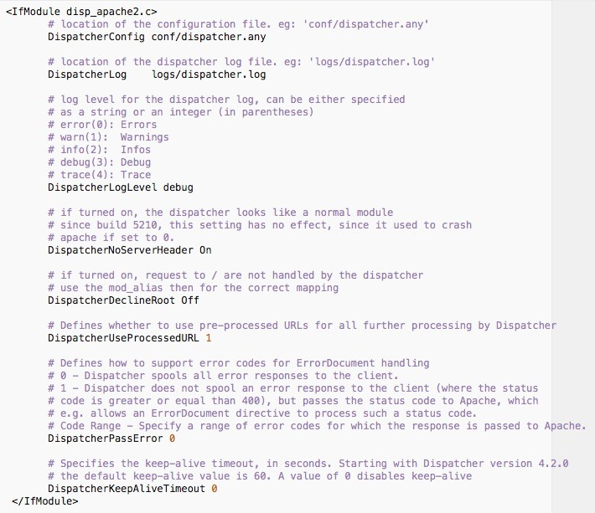

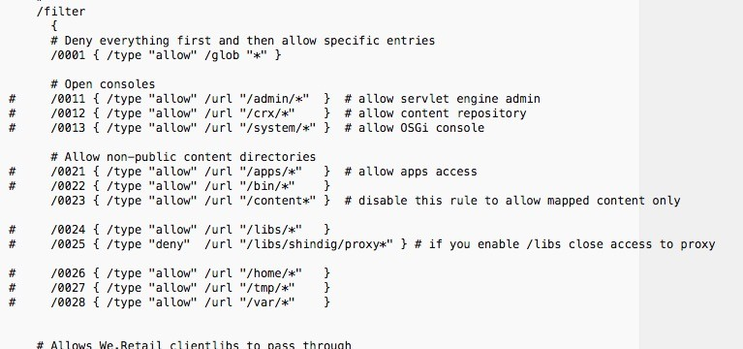
12/2/21
Configuring the Experience Manager Dispatcher
63
AEM 6.5 On Prem Dispatcher Configuration
Same dispatcher that we know and love
Configuration accomplished through httpd.conf and dispatcher.any files
64
©⁶2⁴021 Adobe. All Rights Reserved
64
Adobe Digital Learning Services

Slide 32

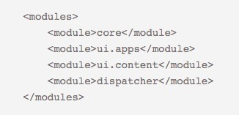

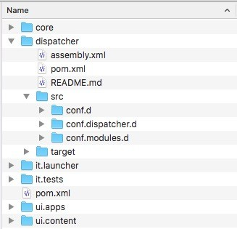

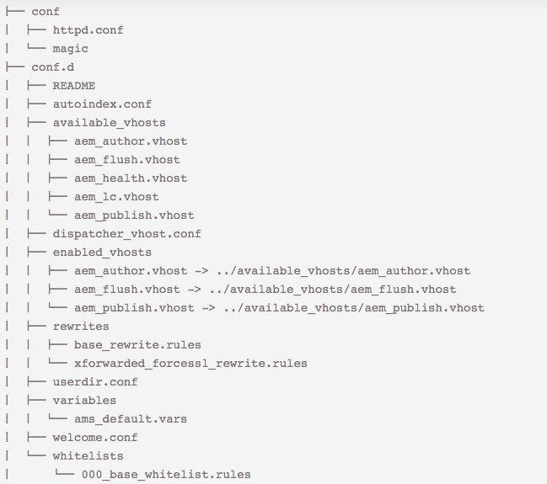

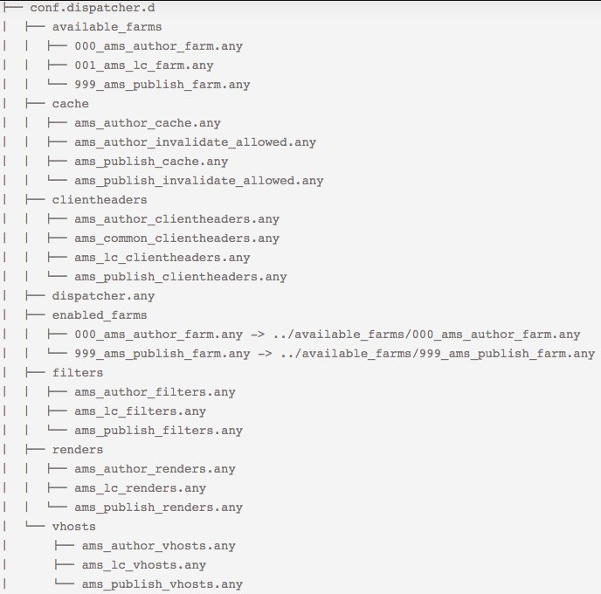

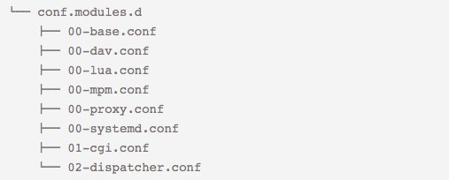
12/2/21
AEM 6.5 AMS Customers - Deploy Dispatcher Configuration with Code
AEM project (from Archetype)
dispatcher module
assembly instructions for dispatcher module
65
©⁶2⁵ 021 Adobe. All Rights Reserved
65
Adobe Digital Learning Services
AEM 6.5 AMS Dispatcher Configuration File Structure (Dispatcher 2.0)
66
©⁶2⁶021 Adobe. All Rights Reserved
66
Adobe Digital Learning Services

Slide 33

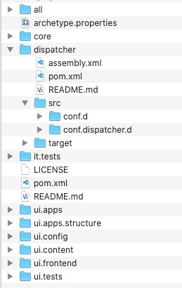

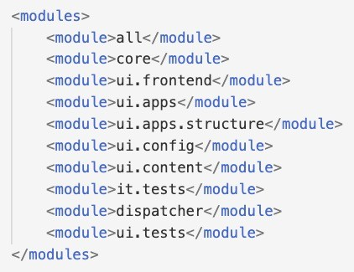


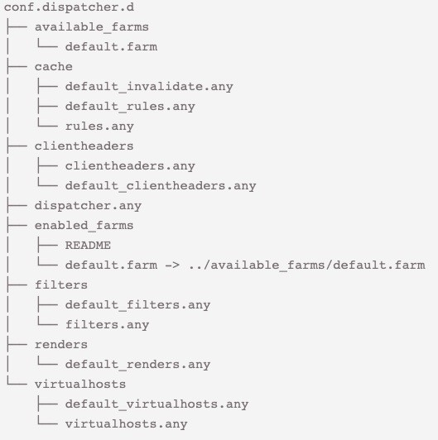

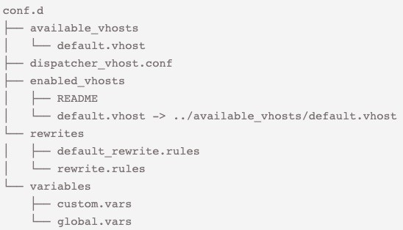
12/2/21
Adobe Experience Manager Cloud Service - Deploy Dispatcher Configuration
dispatcher module
assembly instructions for dispatcher module
AEM project (from Archetype)
67
©⁶2⁷ 021 Adobe. All Rights Reserved
67
Adobe Digital Learning Services
8
Adobe Experience Manager Cloud Service Dispatcher Configuration File Structure
Configuration of
dispatcher.any
Configuration of
httpd..conf
68
© 2021 Adobe. All Rights Reserved
68
Adobe Digital Learning Services

Slide 34

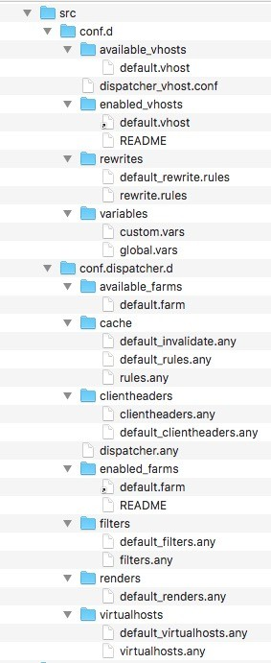

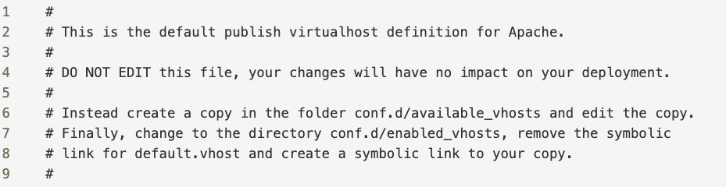

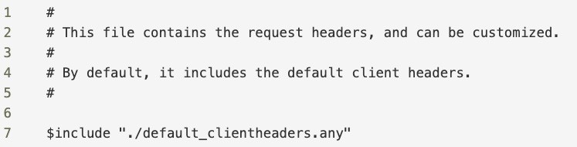
12/2/21
Immutable Files – conf.d and conf.dispatcher.d
Files with ‘default’ in the file name are immutable and cannot be changed. Any changes to the file contents are ignored.
Changes to the dispatcher.any file are also ignored.
If you are in doubt about changing a file, open it to look at the comments for instructions. For example:
69
©⁶2⁹021 Adobe. All Rights Reserved
69
Adobe Digital Learning Services
Customizable Files – conf.d and conf.dispatcher.d
Files that do not have ‘default’ in the name can be customized Files that you have created can be customized
If you are in doubt about changing a file, open it to look at the comments for instructions. For example:
70
©⁷2⁰ 021 Adobe. All Rights Reserved
70
Adobe Digital Learning Services

Slide 35

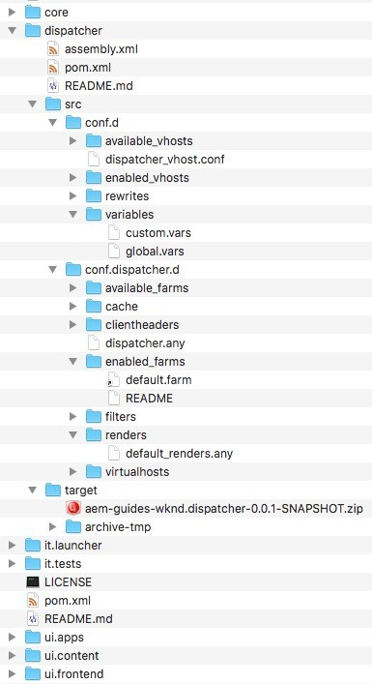
12/2/21
Local Validation and Testing of Dispatcher
71
WKND Dispatcher module
dispatcher /src folder
dispatcher package target folder
dispatcher zip target
72
©⁷2² 021 Adobe. All Rights Reserved
72
Adobe Digital Learning Services

Slide 36

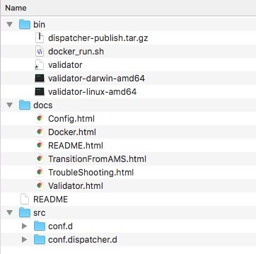

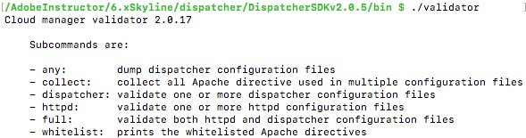
12/2/21
AEM SDK Dispatcher Tools
The AEM SDK Dispatcher tools provide:
Tooling for customers to validate and test dispatcher on docker locally
Documentation for using the tools
Vanilla file structure containing the configuration files to include in a maven project for dispatcher
Docker image run script
validator scripts
Sample dispatcher module
73
©⁷2³ 021 Adobe. All Rights Reserved
73
Adobe Digital Learning Services
Dispatcher SDK - validator Utility
74
©⁷2⁴ 021 Adobe. All Rights Reserved
74
Adobe Digital Learning Services

Slide 37


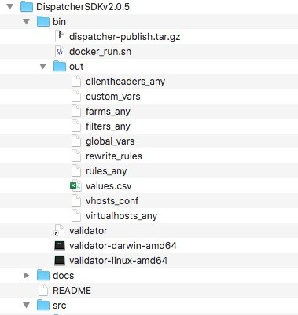
12/2/21
AEM Cloud Service SDK - validator Utility – full -d
$ ./validator full -d <output-foldername> <location-of- dispatcher-configs>/[zip file | src folder]
<output-foldername> - location where the compiled dispatcher config files will be created
zip file – Created by maven (using assembly.xml) and is located in ~dispatcher/target folder
src folder – uncompiled raw ~dispatcher/src folder in your maven project
75
©⁷2⁵ 021 Adobe. All Rights Reserved
75
Adobe Digital Learning Services
Dispatcher tools - validator Utility – create local dispatcher config files
output (dump) folder
76
©⁷2⁶ 021 Adobe. All Rights Reserved
76
Adobe Digital Learning Services

Slide 38

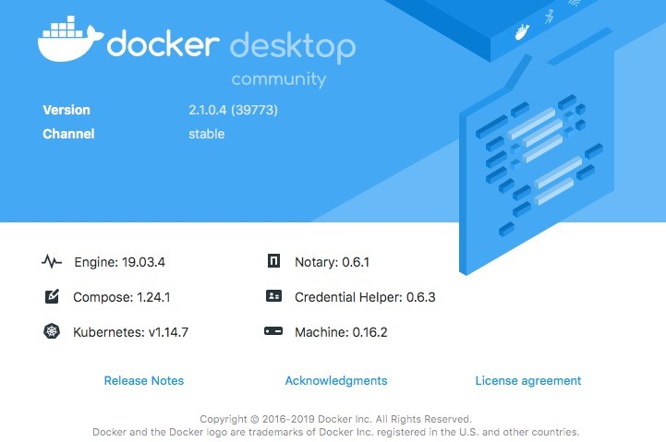

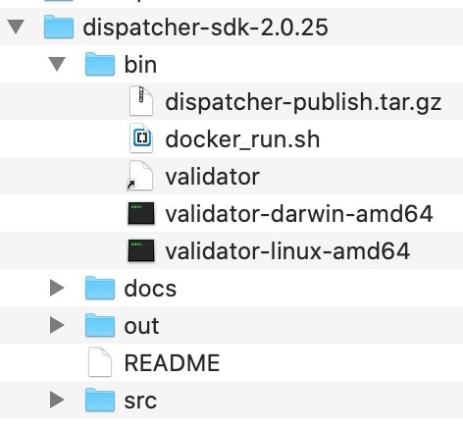



12/2/21
Testing the dispatcher configuration files
Install and run docker
https://docs.docker.com/v17.12/docker-for-mac/install/
https://docs.docker.com/v17.12/docker-for-windows/install/
Once Docker is running
Start the dispatcher image and the out folder generated by the validator
Note: Make sure you share the output folder that contains the dispatcher config files with Docker
77
©⁷2⁷ 021 Adobe. All Rights Reserved
77
Adobe Digital Learning Services
Run Dispatcher Configuration Test – start docker image w/ Apache
Execute docker_run.sh to start the docker image with the apache web server and the dispatcher in it.
folder with dispatcher config files
AEM publish instance IP address and port
Apache port
$ ./docker_run.sh out 192.168.0.14:4503 8080
78
©⁷2⁸ 021 Adobe. All Rights Reserved
78
Adobe Digital Learning Services

Slide 39




12/2/21
Experience Manager publish must be running with your Application
Start AEM Cloud Service local publish instance
$ java –jar aem-sdk-quickstart.jar –r publish –p 4503 -gui
Deploy your application to publish instance
$ mvn clean install –Padobe-public –PautoInstallPackagePublish
Test deployment by accessing application on publish instance http://localhost:4503/content/wknd/us/en.html
79
©⁷2⁹ 021 Adobe. All Rights Reserved
79
Adobe Digital Learning Services
Test Dispatcher Configuration
Test access through the apache web server (in the docker image) by using http://localhost:8080/content/wknd/us/en.html
Success!!
80
©⁸2⁰021 Adobe. All Rights Reserved
80
Adobe Digital Learning Services

Slide 40
12/2/21
Locally validate and test the Dispatcher configuration
You do not have access to the dispatcher in the webserver for AEM as a Cloud Service. As a result, the webserver and dispatcher configurations must be tested before deploying those configurations. Exercise 3: Generate Dispatcher Tools Exercise 4: Validate Dispatcher Configuration (Instructor Demo) Exercise 5: Test the Dispatcher Configuration (Instructor Demo)
© 2021 Adobe. All Rights Reserved 81 Adobe Digital Learning Services
81
OSGi Configuration and Run Modes
82

Slide 41
12/2/21
Custom Runmodes Not Supported
The following runmodes are provided out-of-the-box for Adobe Experience Manager Cloud Service:
author
publish
dev author.dev publish.dev
stage author.stage publish.stage
prod author.prod publish.prod
Note: the only runmodes supported
are in the form: <tier>.<environment>
83
©⁸2³ 021 Adobe. All Rights Reserved
83
Adobe Digital Learning Services
Web Console and OSGi Configuration Changes
Web Console not available in AEM Cloud Service
Changes to OSGi must be introduced via the CI/CD pipeline
Changes to OSGi settings can only come via Git as repository-based OSGi settings
New or updated OSGi bundles must be introduced via Git as part of the CI/CD pipeline build process
84
©⁸2⁴ 021 Adobe. All Rights Reserved
84
Adobe Digital Learning Services

Slide 42




12/2/21
OSGi Configuration JSON Format
85
OSGi Configurations (cont)
Include JSON configuration file in your AEM project
86
© 2021 Adobe. All Rights Reserved
86
Adobe Digital Learning Services

Slide 43




12/2/21
OSGi Configurations
Adobe Experience Manager Cloud Service is backwards compatible with the older JCR node-based format
Best Practice: JSON is the recommended format for OSGI configuration in AEM CS
variable definitions
<PID>.cfg.json
json file
87
©⁸2⁷ 021 Adobe. All Rights Reserved
87
Adobe Digital Learning Services
OSGi Configuration File Contents
/apps/<my-app>/config/com.day.cq.commons.servlets.RootMappingServlet.cfg.json
88
©⁸2⁸ 021 Adobe. All Rights Reserved
88
Adobe Digital Learning Services

Slide 44






12/2/21
OSGi Configuration Values
Inline values
{
“scheduledpurge.workflowStatus” : ”COMPLETED”,
“scheduledpurge.modelIds” : [“publish_example”, “request_for_deactiviation”], “api-key” : ”$[secret:server-api-key]”,
“url” : “$[env:server-url]”
}
Secret values
Environment-specific values
Note: this is not a real configuration definition.
It has been created to demonstrate the different types of values.
89
©⁸2⁹021 Adobe. All Rights Reserved
89
Adobe Digital Learning Services
Environment-specific Configurations
90
© 2021 Adobe. All Rights Reserved
90
Adobe Digital Learning Services

Slide 45







12/2/21
OSGi Configuration Filename Format for Factory Services
com.adobe.granite.workflow.purge.Scheduler~training.cfg.json
Persistent Identity (PID)
unique string for factory
extension
config file
91
©⁹2¹ 021 Adobe. All Rights Reserved
91
Adobe Digital Learning Services
2
Workflow Purge Maintenance Task
92
© 2021 Adobe. All Rights Reserved
92
Adobe Digital Learning Services

Slide 46




12/2/21
3
Generating Configurations
OSGi > OSGi installer Configuration Printer
serialization format
93
© 2021 Adobe. All Rights Reserved
93
Adobe Digital Learning Services
Configure AEM
Best practices specify that OSGi configurations be defined in a JSON configuration file. You can convert your existing XML and node-based OSGi configuration formats by using the OSGi Installer Configuration Printer. Exercise 6: Use the OSGi Installer Configuration Printer Exercise 7: Configure Experience Manager
© 2021 Adobe. All Rights Reserved 94 Adobe Digital Learning Services
94

Slide 47
12/2/21
RepositoryInitializer (repoinit)
95
Repository initialization
Some elements of an application need to be loaded first to install the application successfully
Create/delete/disable service users
Create/delete users and groups
Add access control lists (ACLs)
Add path (for example, for root folder structures)
Add CNDs (nodetype definitions)
Add repository namespaces
SlingRepositoryInitializer processes the configurations before the SlingRepository service is registered
Enables initialization
Controlled by use of repoinit script
Useful for initialization and content migration purposes
96
© 2021 Adobe. All Rights Reserved
96
Adobe Digital Learning Services

Slide 48














12/2/21
Repository Initialization Language (repoinit)
Example language
97
© 2021 Adobe. All Rights Reserved
97
Adobe Digital Learning Services
Repoinit configuration
98
© 2021 Adobe. All Rights Reserved
98
Adobe Digital Learning Services

Slide 49




12/2/21
Caution: Syntax
99
© 2021 Adobe. All Rights Reserved
99
Adobe Digital Learning Services
Exercise 8: Use repoinit statements to define service user ‘training-user’
Servlets often require permissions to perform their jobs. The permissioning context for the servlets is provided by service users. Those service users can be defined and permissioned before the servlet starts.
© 2021 Adobe. All Rights Reserved 100 Adobe Digital Learning Services
100

Slide 50




12/2/21
Shared Maintenance Tasks
101
Maintenance Task Configuration
Maintenance Task configurations must be persisted in source control
Tools > Operations screen no longer available in Cloud environments
Ensures changes are intentionally persisted rather than reactively applied and perhaps forgotten
For example, Workflow Purge
102
©¹⁰2²021 Adobe. All Rights Reserved
102
Adobe Digital Learning Services

Slide 51


12/2/21
Experience Manager maintenance tasks
Maintenance tasks are:
OSGi Configuration stored in /apps
Added to a single Maintenance window
Maintenance windows:
Are context aware config stored in /apps
Have a start and end date and time
- If a task is not complete within the defined time, it continues in the next window
Can be set daily, weekly, or monthly
103
© 2021 Adobe. All Rights Reserved
103
Adobe Digital Learning Services
Control repository size with maintenance tasks
Tasks owned by Adobe:
Datastore Garbage Collection Tasks that have shared ownership:
Version Purge
Audit Log Purge
Task owned by the customer:
Ad-hoc Task Purge
Workflow Purge
Project Purge
104
© 2021 Adobe. All Rights Reserved
104
Adobe Digital Learning Services

Slide 52
12/2/21
Adobe owned and shared tasks
Adobe Owned
Adobe owns the maintenance window and OSGi Configuration of:
Datastore garbage collection
Shared
Adobe owns the maintenance window
Customer owns the OSGi Configuration:
com.day.cq.wcm.core.impl.VersionPurgeTask
Purge path, max or min number versions and max version age
com.adobe.cq.audit.purge.Pages (factory)
Content path, min age, and page events to audit
Adobe owns the right to override these configurations to mitigate performance degradation
105
© 2021 Adobe. All Rights Reserved
105
Adobe Digital Learning Services
Customer owned tasks
Adjust maintenance window configurations
Add or remove tasks in each window
Configure running windows Can Modify OSGi configurations of:
com.adobe.granite.taskmanagement.impl.purge.TaskPurgeMaintenanceTask
com.adobe.granite.workflow.purge.Scheduler (factory)
0 to many configurations
com.adobe.cq.projects.purge.Scheduler (factory)
0 to many configurations
OSGi configurations must be stored in /apps/*/config folders
106
© 2021 Adobe. All Rights Reserved
106
Adobe Digital Learning Services

Slide 53
12/2/21
Developer Guidelines
107
Adobe Experience Manager as a Cloud Service is always a cluster
Code running in Adobe Experience Manager as a Cloud Service
must be aware of the cluster
must be resilient
During an update of Adobe Experience Manager as a Cloud Service:
instances with old and new code are running in parallel
old code must not break with content created by new code
new code must be able to deal with content created by old code
108
© 2021 Adobe. All Rights Reserved
108
Adobe Digital Learning Services

Slide 54
12/2/21
State
Memory should not be used to keep state
Any state must be persisted in the repository
File system should not be used in Adobe Experience Manager as a Cloud Service
Disk is transitory and will be destroyed when instances are recycled
Temporary storage relating to the processing of single requests is possible
Temporary storage should not be abused for huge files
109
©¹⁰2⁹021 Adobe. All Rights Reserved
109
Adobe Digital Learning Services
Observation
JCR events and Sling resource observation events
cannot be guaranteed to be executed locally
must be used with care
Example: When a change is happening, the instance may be taken down and replaced by a different instance.
Other instances in the topology, active at the time, will be able to react to that event.
However, this will not be a local event
110
©¹¹2⁰021 Adobe. All Rights Reserved
110
Adobe Digital Learning Services

Slide 55
12/2/21
Background Tasks and Long Running Jobs
Background tasks must assume that the instance it is running in can be brought down at any time Code must be
resilient
resumable
Long running jobs should be avoided if possible. If necessary, use
Sling Jobs
Sling jobs scheduler
111
©¹¹2¹ 021 Adobe. All Rights Reserved
111
Adobe Digital Learning Services
Outgoing http Connections
Recommended:
Any outgoing HTTP connections set reasonable connect and read timeouts.
If not used, Adobe Experience Manager as a Cloud Service will enforce a global timeouts.
Use the provided Apache HttpComponents Client 4.x library for making HTTP connections
112
©¹¹2²021 Adobe. All Rights Reserved
112
Adobe Digital Learning Services

Slide 56
12/2/21
Key Takeaways
General Cloud Service Deployment Process
Code is managed in a customer git repo
Normal development occurs
Branches can then be pushed into the Cloud Manager git for Cloud
Code is tested in non-production before moving to production
Use the Cloud Service SDK
Local Development environment is not exactly the same
New Dispatcher project module
113
© 2021 Adobe. All Rights Reserved
113
Adobe Digital Learning Services
Key Takeaways
Configuring Dispatcher in the Cloud
Dispatcher Configuration deployed as part of the Experience Manager project
Familiar httpd.conf and dispatcher.any files have been broken up into smaller pieces
SDK provides validation scripts and docker image for testing dispatcher configuration
114
© 2021 Adobe. All Rights Reserved
114
Adobe Digital Learning Services

Slide 57






12/2/21
Introduction to Cloud Manager
© 2021 Adobe. All Rights Reserved
115
© 2021 Adobe. All Rights Reserved 115 Adobe Digital Learning Services
Cloud manager for Adobe Experience Manager (AEM)
Self Service Portal
Easily access & manage the cloud environment and CI/CD pipeline
CI/CD Pipeline
Code inspection, performance testing, and security validation
Flexible Deployments
Schedule code deployments during specified time frames
Auto-scaling
Detects the need for additional capacity during unexpected spikes
116
© 2021 Adobe. All Rights Reserved
116
Adobe Digital Learning Services

Slide 58





12/2/21
Autoscaling in action P D P D Existing Publisher-Dispatcher Tiers | Load Spike |  | Autoscaling Event Triggered | P D P D P D P D New Tiers added via Cloud Manager Autoscaling
© 2021 Adobe. All Rights Reserved | 117 |  | Adobe Digital Learning Services
117
Cloud Manager Terminology
Solution | One of the Adobe Experience Cloud solutions, such as AEM, or Adobe Target, or Adobe Analytics.
Organization | An Adobe construct representing an Enterprise customer. One company may have multiple organizations depending on how they were originally provisioned in Adobe's Identity Management System (IMS).
Product | A specific set of functionality within a solution licensed by an organization. Different programs within an organization may be entitled to different sets of products. For example, Sites, Assets of Forms.
Program | A set of environments that support a logical grouping of customer initiatives and usually corresponds to a purchased Service Level Agreements (SLA).
Environment | A single set of virtual machines within a Program. For AEM, this is composed of an author instance, zero or more publish instances, one or more dispatcher instances, a CDN, and a load balancer.
118
© 2021 Adobe. All Rights Reserved
111188
Adobe Digital Learning Services

Slide 59






12/2/21
Cloud Manager Terminology (cont)
Application | Set of customizations and configurations created by a customer to adapt the underlying solution for their specific use cases.
Artifact | A deployable unit. The result of some build process that transforms source code into a single unit.
Artifact Repository | A storage location where customer-specific artifacts are saved and secured.
Git Repository | A location where customer-specific source code is stored and made accessible by using the Git protocol.
Deployment (CI/CD) Pipeline | A set of deployment steps that are executed in sequence.
Instance | A specific virtual server running the AEM solution. Instances represent a single logical unit from a deployment perspective.
119
© 2021 Adobe. All Rights Reserved
111199
Adobe Digital Learning Services
Cloud manager entities
Adobe Cloud Manager
Single entry point for the Operations & Developer Personas to create and manage components of
AEMaaCS
Programs Environments Pipelines
Program: High-level entity, typically Environment: composed of an CI/CD Pipeline: enables AEM
associated with a service level author tier and a publish tier. Cloud project teams to quickly, safely and
agreement (contract) that contains Manager environments typically consistently deploy code to AEM
production and non-production have one production environment environments
environments and one stage environment. Cloud manager enables self-service
creation of CI/CD pipelines that
Cloud manager enables self-service Cloud manager enables self-service enforce best practices
creation of AEM applications (AEM creation of AEM environments
Sites, AEM Assets) within a program (production and non-production)
© 2021 Adobe. All Rights Reserved | 120 | Adobe Digital Learning Services
120

Slide 60


12/2/21
Setting up a Program
Requires Business Owner role Define and configure:
Program description
Experience Manager product
Key Performance Indicators (KPIs) that will be used for performance testing
- Defined KPIs serve as a baseline for performance testing which is passed each time the pipeline executes.
121
© 2021 Adobe. All Rights Reserved
121
Adobe Digital Learning Services
Managing Environments
Production and Stage Environment:
Production and Stage duo, always deployed as a pair, is used for testing and production purposes
Associated with Production pipeline
Development:
Development environment can be created for development and testing purposes
Associated with non-Production pipelines
122
© 2021 Adobe. All Rights Reserved
122
Adobe Digital Learning Services

Slide 61


12/2/21
CI/CD Pipelines
Production
Can be configured once the stage/prod pair has been created
Always executes the build and code quality steps
Deploys to stage
Deploys to prod, once the release trigger has been satisfied
Non-Production
Always executes the build and code quality steps
Optionally also deploy to Adobe Experience Manager as a Cloud Service dev environment
123
© 2021 Adobe. All Rights Reserved
123
Adobe Digital Learning Services
Cloud Manager Git
124
© 2021 Adobe. All Rights Reserved
124
Adobe Digital Learning Services

Slide 62


12/2/21
AEM services naming
Adobe Experience Manager Cloud Service (Product)
https://my.cloudmanager.adobe.com/<UID>
<programName>-<envName>-[author | publish] (instance)
<programName>-<envName>-[author | publish] (instance)
instances = Experience Manager Services
cloudmanager instance = Governs Cloud Manager
125
© 2021 Adobe. All Rights Reserved
125
Adobe Digital Learning Services
Managing Enviroment with Cloud Manager
One of the first tasks of the DevOps persona is to create and manage a development (non-production) environment. Exercise 1: Access a Training Program using Cloud Manager Exercise 2: Create a Dev Environment
© 2021 Adobe. All Rights Reserved 126 Adobe Digital Learning Services
126

Slide 63
12/2/21
Admin Console
127
Admin console
Admin Console manages all users and groups in the Adobe Experience Cloud Users can be added product profiles in the Admin Console
Product profiles give access to Cloud Manager, Experience Manager and other Adobe products Administrators use the Adobe Admin Console to
Create, import, and manage user accounts
Assign users to different Adobe products
Add users to product profiles (groups) to manage higher level products permissions
128
© 2021 Adobe. All Rights Reserved
128
Adobe Digital Learning Services

Slide 64




12/2/21
Terminology in the Admin console
Products
Target, Analytics, Audience Manager (Products)
Adobe Experience Manager Cloud Service (Product) Product Profiles
Like Groups in AEM, pre-defined in the Cloud environment
Used to control the access for Products Users
Individual user can access different Products in Cloud
Typically coming from IMS or external ID services
instances = Experience Manager Services
Cloud manager instance = Governs Cloud Manager
© 2021 Adobe. All Rights Reserved 129
129
Adobe Digital Learning Services
Understanding different Admin roles in Cloud
System Admin
Federated ID
Enterprise ID
Adobe ID
Experience Manager Product Admin
Add users to Cloud Manager
Add users to AEM Services
Create new product profiles for group membership
Experience Manager Admin
Manages Experience Manager group
permissions (within AEM)
AEM Admin will be the focus of this Module
130
© 2021 Adobe. All Rights Reserved
130
Adobe Digital Learning Services

Slide 65






12/2/21
Experience Manager Product profiles
Experience Manager as a Cloud Service (Product)
AEM Service (Instance)
AEM Users-<UID> (profile)
AEM Administrators-<UID> (profile)
<custom profiles> (profile)
AEM Profiles are synced as AEM groups
Via “Adobe Granite OAuth IMS Provider”
ims.group.mapping property
Group’s permission is managed within the AEM Service
instances = AEM Services
Cloud manager instance = Governs Cloud Manager
131
© 2021 Adobe. All Rights Reserved
131
Adobe Digital Learning Services
Experience Manager Product profiles in Admin Console
Admin Console Governance
Cloud Manager
Program n
Controls AEM Service Authentication
Separate access per service
Program 1
Prod environment Author service Publish service
Stage environment Author service Publish service
Dev environment Author service Publish service
Program 2
Program 3
132
© 2021 Adobe. All Rights Reserved
132
Adobe Digital Learning Services

Slide 66



12/2/21
Cloud manager profiles
Cloud Manager & Profiles (Product)
https://my.cloudmanager.adobe.com/<UID> Each profile is outlined on helpx.
In general:
Business Owner - full control
Deployment Manager – manages pipelines
Developer – access to git/pipelines
Integrations – for services
Program Manager – Mainly read and some execution permissions
133
© 2021 Adobe. All Rights Reserved
133
Adobe Digital Learning Services
Demonstration
Explore the Admin Console, user and product profiles
134
© 2021 Adobe. All Rights Reserved
134
Adobe Digital Learning Services

Slide 67


12/2/21
Adobe IMS
135
IMS for Experience Manager authentication
Customer onboarding to the Admin console is a prerequisite Must have an IMS organization provisioned by Adobe
Joint effort between Adobe and customers Supports Local and IMS authentication
136
© 2021 Adobe. All Rights Reserved
136
Adobe Digital Learning Services

Slide 68
12/2/21
Adobe Identity Management System (IMS)
An authentication service for all Adobe products Can be configured with a customer’s
SSO
LDAP
Other Identity Providers (IDP)
Experience Manager IMS service accounts are tightly integrated with
Adobe Launch
Adobe Target
Adobe Stock
Any Adobe I/O connection
137
© 2021 Adobe. All Rights Reserved
137
Adobe Digital Learning Services
IMS IDs
Three types of identities of accounts to authenticate and authorize users:
Federated ID
Enterprise ID
Adobe ID
The Enterprise and Federated ID models are an ideal choice for enterprises. The Adobe ID is best suited for individuals.
138
© 2021 Adobe. All Rights Reserved
138
Adobe Digital Learning Services

Slide 69





12/2/21
IMS architecture
139
© 2021 Adobe. All Rights Reserved
139
Adobe Digital Learning Services
Developer Console
140
© 2021 Adobe. All Rights Reserved
140
Adobe Digital Learning Services

Slide 70




12/2/21
Developer Console as a Debugging Tool
141
© 2021 Adobe. All Rights Reserved
141
Adobe Digital Learning Services
Optional Exercise 3: Use the Developer Console to Download the Current OSGi Configurations
Since developers do not have direct access to the Web Console, the Cloud Manager provides the Developer Console for each environment. The Developer Console can be used to troubleshoot application issues.
© 2021 Adobe. All Rights Reserved 142 Adobe Digital Learning Services
142

Slide 71
12/2/21
Adobe I/O
Adobe I/O is the API endpoint for Adobe Experience Platform. Adobe I/O supported services:
Adobe Sensei
Adobe Stock
Smart Tags
Adobe Asset Link
Brand Portal
Cloud Manager
Adobe Experience Platform including:
Adobe’s tag management system
Adobe Target
Adobe Analytics
Adobe Audience Manager
Marketo
143
© 2021 Adobe. All Rights Reserved
143
Adobe Digital Learning Services
Adobe I/O CLI and the aio plugin for Cloud Manager
Command-line functionality for accessing Adobe I/O APIs. Provides a core set of endpoints and syntax
Adobe solutions add their own endpoints for specific functionality
aio plugin for Cloud Manager offers commands that enable you to control and manage the CI/CD pipeline and environments in Cloud Manager programs
144
© 2021 Adobe. All Rights Reserved
144
Adobe Digital Learning Services

Slide 72
12/2/21
aio plugin for Cloud Manager command examples
aio cloudmanager
aio cloudmanager:list-environments] aio cloudmanager:list-pipelines]
aio cloudmanager:start-execution PIPELINEID]
aio cloudmanager:get-current-execution PIPELINEID]
aio cloudmanager:advance-current-execution PIPELINEID] aio cloudmanager:cancel-current-execution PIPELINEID]
aio cloudmanager:get-execution-step-details PIPELINEID EXECUTIONID]
aio cloudmanager:get-execution-step-log PIPELINEID EXECUTIONID ACTION] aio cloudmanager:tail-log ENVIRONMENTID SERVICE NAME]
145
© 2021 Adobe. All Rights Reserved
145
Adobe Digital Learning Services
Key Takeaways
Cloud Manager UI Cloud Manager entities
Program
Environment
Dev
Stage and Prod pair
Developer Console
Pipeline
Production and non-Production
Admin Console and IMS Products and Profiles
Adobe I/O and the aio Cloud Manager plugin
146
© 2021 Adobe. All Rights Reserved
146
Adobe Digital Learning Services

Slide 73
12/2/21
Deploy to Adobe Experience Manager as a Cloud Service
147
147
Blue-Green Deployment Model - Rolling Deployments
Process any indexes for which there are new or updated index definitions
Note: Blue deployment will always use the old indexes, while Green will always use the new indexes
Blue is still serving while Green is starting up
Blue is running and serving while Green is being checked for readiness via health checks
Green nodes accept traffic as they become ready
Green nodes replace Blue nodes, which are brought down
Over time, Blue nodes are replaced by Green nodes until only Green remain
Any new or modified mutable content is deployed
148
©¹⁴2⁸021 Adobe. All Rights Reserved
148
Adobe Digital Learning Services

Slide 74
12/2/21
Content Packages
Content packages written for Cloud Service applications must have a clean separation between immutable and mutable content
Immutable Content
All content and code persisted in the immutable repository must be checked into github repository and deployed through Cloud Manager
This includes OSGi configurations Mutable Content
Deploy as mutable content packages using Cloud Manager
- Requires content be stored in github repository
Repoinit statements
149
© 2021 Adobe. All Rights Reserved
149
Adobe Digital Learning Services
Adobe Experience Manager Releases
Previous Experience Manager solutions:
Experience Manager version changed infrequently
Customers update the production instances to the latest quickstart.jar on their own time AEM as a Cloud Service applications:
Automatically updated to the latest version of Experience Manager more often
Custom code for customer application releases should be built against latest Experience Manager interfaces
150
©¹⁵2⁰021 Adobe. All Rights Reserved
150
Adobe Digital Learning Services

Slide 75







12/2/21
Adobe Experience Manager Version Updates
Experience Manager will be updated frequently, potentially as often as once a day
Focus on bug fixes and performance enhancements
Happens transparently and without causing downtime
Intended to be backwards compatible
Independent events from customer code deployments
Deployed on top of last successful customer code push
151
©¹⁵2¹021 Adobe. All Rights Reserved
151
Adobe Digital Learning Services
AEM Cloud Service: Deployment Architecture
Customer Code Changes
Adobe Release Orchestration
Customer Code CI/CD
Baseline AEM Releases
Code Building/Testing
Image Building
Non-Production Environment
Adobe Release Validation
Adobe Code CI/CD
Stage Deployment
Security Testing
Staging Environment
Regression Testing
Adobe Code Changes
Performance Testing
Several Times a Day
Prod Deployment
Production Environment
© 2021 Adobe. All Rights Reserved
152
Adobe Digital Learning Services
152
© 2021 Adobe. All Rights Reserved 152 Adobe Digital Learning Services

Slide 76
12/2/21
Adobe Experience Manager Feature Releases
Occur on a monthly cadence
Focus on feature additions and enhancements
Impact more substantially the user experience compared to the daily releases
Triggered by the flip of a release toggle, activating code that has been accumulating over the course of days or weeks through the daily updates
153
©¹⁵2³021 Adobe. All Rights Reserved
153
Adobe Digital Learning Services
AEM Version Updates and the Composite Nodestore
Rolling updates are possible due to the "composite node store" feature in Oak Allows AEM to reference multiple repositories simultaneously
New Green Experience Manager version and older Blue version each contains its own /libs (immutable)
Both Green and Blue versions reference a shared mutable repository that contains areas like /content , /conf , /etc and others
Since both the Blue and the Green have their own versions of /libs
Both are active during the rolling update
Both are taking on traffic until the Blue is fully replaced by the Green
154
©¹⁵2⁴021 Adobe. All Rights Reserved
154
Adobe Digital Learning Services

Slide 77







12/2/21
AEM Updates and Deployed Customer Code
Experience Manager updates and release orchestration are separate deployment events from pushing customer custom code:
Updates that happen after customer code has been deployed are automatically applied
Updates are intended to be backwards compatible with the customer code already deployed
Custom code releases should be tested against the Experience Manager version that is on production
155
©¹⁵2⁵021 Adobe. All Rights Reserved
155
Adobe Digital Learning Services
AEM Cloud Service: Deployment Architecture
Adobe Release Orchestration
Customer Code Changes
Customer Code CI/CD
Baseline AEM Releases
Code Building/Testing
Image Building
Non-Production Environment
Adobe Release Validation
Adobe Code CI/CD
Stage Deployment
Security Testing
Staging Environment
Regression Testing
Adobe Code Changes
Performance Testing
Several Times a Day
Prod Deployment
Production Environment
© 2021 Adobe. All Rights Reserved
156
Adobe Digital Learning Services
156
© 2021 Adobe. All Rights Reserved 156 Adobe Digital Learning Services

Slide 78






12/2/21
Deploy Using Cloud Manager
157
8
Traditional Experience Manager Deployment Workflow
QA
Operations
Developer
Dev/QA
Staging
Production
UAT
Many times per day
© 2021 Adobe. All Rights Reserved
Many times per sprint
158
Once per sprint Once per release
Adobe Digital Learning Services
158
© 2021 Adobe. All Rights Reserved 158 Adobe Digital Learning Services

Slide 79










12/2/21
9
How Does Cloud Manager Fit In?
QA
Operations
Pull
Push
Customer Repo
CM Repo
Dev/QA
Staging
Production
UAT
Cloud Manager
develop/release
master
© 2021 Adobe. All Rights Reserved
159
Adobe Digital Learning Services
159
© 2021 Adobe. All Rights Reserved 159 Adobe Digital Learning Services
0
Continuous integration and delivery: CI/CD Process Flow
Code in Adobe git
Build code
Unit Tests
Code
Deploy to Security Load Perf
Deploy to Prod
Inspection Stage test generator test
1
2
3
4
5
6
7
8
9
Git
Prod
Automated with user control, and test results as needed
Git
Pipeline
Stage
Prod
© 2021 Adobe. All Rights Reserved
160
Adobe Digital Learning Services
160
© 2021 Adobe. All Rights Reserved 160 Adobe Digital Learning Services

Slide 80


12/2/21
CI/CD Pipeline
Cloud Manager includes a Continuous Integration (CI) and Continuous Delivery (CD) framework
Implementation teams:
Quickly test and deliver new or updated code
Set up, configure, and start an automated CI/CD pipeline that leverages Adobe coding best practices
Pipeline
Automates unit and performance testing processes
Increases deployment efficiency and pro-actively identify critical issues
161
©¹⁶2¹021 Adobe. All Rights Reserved
161
Adobe Digital Learning Services
Pipeline
Connects Git branch with environments Runs series of quality/security tests Trigger Options
Failure Behavior
Git SSH information Two Types
Non-production
Production
162
©¹⁶2²021 Adobe. All Rights Reserved
162
Adobe Digital Learning Services

Slide 81




12/2/21
Non-Production Pipelines
0 to many pipelines
Types: Code Quality or Deployment
Deployment Env (not needed for Code Quality)
Git Branch (code to deploy)
Pipeline Options (trigger and failure behavior)
163
©¹⁶2³021 Adobe. All Rights Reserved
163
Adobe Digital Learning Services
Non-Production Pipeline Stages
Pipeline Stages
Validation (sanity checks)
Build & Unit testing
Code Scanning (verified against AEM SonarQube Rules)
Build Images
Deploy to Dev Environment
164
©¹⁶2⁴021 Adobe. All Rights Reserved
164
Adobe Digital Learning Services

Slide 82






12/2/21
Production Pipeline Setup
Stage/Production environment set (0-1) Testing Options
Stage
Git code Branch
Deployment trigger, failure behavior, and testing decisions
Production
Production Deployment Options
165
©¹⁶2⁵021 Adobe. All Rights Reserved
165
Adobe Digital Learning Services
Production Pipeline Stages
Stage Deployment
Validation (sanity checks)
Build & Unit testing
Code Scanning (verified against AEM SonarQube Rules)
Build Images
Deploy to Stage Environment
Stage Testing
Product Functional Testing
Custom Functional Testing
Production Deployment
Deploy to production
166
©¹⁶2⁶021 Adobe. All Rights Reserved
166
Adobe Digital Learning Services

Slide 83




12/2/21
Logs
Logs available through UI
Downloaded through UI page or environment page
Logs through API
List environments to get ID (1234)
$ aio cloudmanager:list-environments
List available logs
$ aio cloudmanager:list-available-log-options 1234
Download logs
$ aio cloudmanager:download-logs --programId 5 1234 author aemerror
Tail logs
$ aio cloudmanager:tail-log --programId 5 1234 author aemerror
167
©¹⁶2⁷021 Adobe. All Rights Reserved
167
Adobe Digital Learning Services
SonarQube
Standard open source testing platform
Used to measure and analyze the source code quality Four types of rules used:
Code Smell (Maintainability domain)
Bug (Reliability domain)
Vulnerability (Security domain)
Security Hotspot (Security domain)
168
© 2021 Adobe. All Rights Reserved
116688
Adobe Digital Learning Services

Slide 84


12/2/21
Exercise 1: Define and Initiate a Code Quality Pipeline
CI/CD pipelines are used to deploy to Adobe Experience Manager as a Cloud Service. Code quality pipelines allow the developers to run their code through the code quality gates before actually deploying the application code to an environment.
© 2021 Adobe. All Rights Reserved 169 Adobe Digital Learning Services
169
Developing for CI/CD
Developers must be aware of code quality
Code will not be loaded onto AEM as a Cloud service if there are Critical issues Best practices need to be used
CSV reports created by SonarQube are extremely useful Use SonarQube Rules documentation as help
Use Experience Manager’s custom rules documentation as help
170
©¹⁷2⁰021 Adobe. All Rights Reserved
170
Adobe Digital Learning Services

Slide 85


12/2/21
Code Scanning Results (in pipeline)
CM groups Issues into 3 groups
Code Quality
Performance Testing
Security Testing
Groups are separated into 3 severity levels
Critical – fails the pipeline. Must be fixed to continue
Important – Pauses the pipeline. Can be overridden or ignored
Information – No impact on the pipeline execution
171
©¹⁷2¹021 Adobe. All Rights Reserved
171
Adobe Digital Learning Services
Code Quality using SonarQube
Run with ALL pipeline types (code quality, development, production) Groups issues into 4 categories
Code Smell (Maintainability domain)
Bug (Reliability domain)
Vulnerability (Security domain)
Security Hotspot (Security domain)
Rules executed:
Squid - Standard SonarQube Java rules
Sonar Plugins
AEM – AEM Rules (By Cognifide)
CQ – AEMaaCS Rules (By Adobe)
172
©¹⁷2²021 Adobe. All Rights Reserved
172
Adobe Digital Learning Services

Slide 86




12/2/21
Performance and Security Tests
Production Pipeline only
Runs on Stage Environment
Performance Testing
Based on KPIs on program
Loaded content into pipeline Security Testing
Based on existing Experience Manager health checks
Pass/Fail only
173
©¹⁷2³021 Adobe. All Rights Reserved
173
Adobe Digital Learning Services
Understand your Test Results
https://docs.adobe.com/content/help/en/experience-manager-cloud-manager/using/how-to-use/understand-your-test-results.html
174
© 2021 Adobe. All Rights Reserved
174
Adobe Digital Learning Services

Slide 87






12/2/21
Example CSV output
Exact file, line#, what to fix and how long
Full categorization (Type, Severity, Rule, Tags)
Quick documentation links
175
©¹⁷2⁵021 Adobe. All Rights Reserved
175
Adobe Digital Learning Services
Exercise 2: Work with the custom code quality gates
The code quality rules help developers ensure that their code is stable and secure. The Cloud Manager code quality tests return results that assist the developer in correcting issues in their code.
© 2021 Adobe. All Rights Reserved 176 Adobe Digital Learning Services
176

Slide 88
12/2/21
Index Management
177
Changes in Indexing
Indexes are no longer configured and maintained on single Experience Manager instances Index definitions and configurations are deployed across the entire service
Configuration changes in production break CI/CD policies and are not supported
Index configuration must be defined before deployment
Index definitions (/oak:index/*) are deployed within the ui.apps module
Limitations: Currently, index management on Adobe Experience Manager as a Cloud Service is only supported for indexes of type lucene
178
© 2021 Adobe. All Rights Reserved
178
Adobe Digital Learning Services

Slide 89
12/2/21
Use Cases for Index Management
Adding a new customer index definition Updating an existing index definition
Means adding a new version of an existing index definition
Removing an existing index that is redundant or obsolete
179
©¹⁷2⁹021 Adobe. All Rights Reserved
179
Adobe Digital Learning Services
Index management with Blue-Green deployment
No downtime
Indexes only used by certain versions of the application, for example:
Adding an index in version 3 of the application
Index should not be used by version 1 of the application
Removing index in version 3 of the application
Still required for version 1 of the application
Changing an index definition:
Old version of the index only to be used for version 1, and the new version of the index only to be used for version 3
180
©¹⁸2⁰021 Adobe. All Rights Reserved
180
Adobe Digital Learning Services

Slide 90




12/2/21
81
Blue-Green Index Management Example
181
© 2021 Adobe. All Rights Reserved
181
Adobe Digital Learning Services
Configuring the Oak Index
Indexes are configured as nodes in the repository under the oak:index node
Several configuration options are available for each indexer as node properties:
Property Index **
Ordered Index **
Lucene Full Text Index
Lucene Property Index
SOLR Index.**
** Index Management not yet supported with AEM Cloud Service
182
©¹⁸2²021 Adobe. All Rights Reserved
182
Adobe Digital Learning Services

Slide 91
12/2/21
Adobe Experience Manager Cloud Service Indexing
Index changes initiated before going to production to ensure quality gateways in the Cloud Manager pipelines
Index configuration changed via code deployments
Due to Blue-Green deployment model two sets of indexes will exist:
one set for the old version (blue)
one set for the new version (green)
Version of the index that is used is configured using flags in the index definitions via the useIfExist flag Status of indexing job on the Cloud Manager build page
Limitations: currently, index management on AEM as a Cloud Service is only supported for indexes of type lucene.
183
©¹⁸2³021 Adobe. All Rights Reserved
183
Adobe Digital Learning Services
Index Definition Package
Prepare a new index definition package that contains the actual index definition, following this naming pattern:
<indexName>[-<productVersion>]-custom-<customVersion>
Place it under ui.apps/src/main/content/jcr_root
Resulting package named similar to:
com.adobe.granite:new-index-content:zip:1.0.0-SNAPSHOT
184
©¹⁸2⁴021 Adobe. All Rights Reserved
184
Adobe Digital Learning Services

Slide 92
12/2/21
Deploying Index Definitions
Index definitions are now marked as custom and versioned
for example /oak:index/ntBaseLucene-custom-1
To deploy an index:
typically delivered in ui.apps via Git and the Cloud Manager deployment process
185
©¹⁸2⁵021 Adobe. All Rights Reserved
185
Adobe Digital Learning Services
After Index Deployment
Application needs to be deployed via Cloud Manager
Upon deployment two jobs are started for adding (and merging if needed) index definitions for author and publish
Underlying repositories are re-indexed with the new index definitions before the Blue-Green switch takes place
186
©¹⁸2⁶021 Adobe. All Rights Reserved
186
Adobe Digital Learning Services

Slide 93
12/2/21
Potential Changes in Deployment Practices
187
Changes in Deployment Strategies and Processes
Existing development and deployment processes for on premises and Adobe Managed Services deployments may have to change when deploying to Adobe Experience Manager as a Cloud Service. For example:
Deployment (CI/CD) pipeline
Source code repository practices
Coding practices
Local development
188
©¹⁸2⁸021 Adobe. All Rights Reserved
188
Adobe Digital Learning Services

Slide 94

12/2/21
Preparing to move an existing application
Application code and configuration must be stored in the Git code repository of the associated Cloud Manager program
Application code and configuration must be compatible with the latest version of the baseline AEM image (which might be changing daily)
Customer application must be built and deployed using the Cloud Manager pipeline associated to the Cloud Manager environment
Customer application must pass all the code quality, security and performance gates enforced in the pipeline
The images built for the customer application must be deployed by the Cloud Manager pipeline
189
©¹⁸2⁹021 Adobe. All Rights Reserved
189
Adobe Digital Learning Services
Adobe Experience Manager as a Cloud Service and Github repositories
Adobe Cloud Manager comes provisioned with a single git repository
Used to deploy code using Cloud Manager's CI/CD pipelines
Customers integrate on-premises or customer-managed git repository with Cloud Manager
All code and configurations should be managed and versioned in the the customer-managed git repository
IMS Tenant
190
©¹⁹2⁰021 Adobe. All Rights Reserved
190
Adobe Digital Learning Services

Slide 95


12/2/21
Runmodes
OSGI configuration run modes must reference:
dev, stage, prod for the environment
author, publish for the service
A combination of <service>.<environment_type> is supported in this particular order
for example author.dev or publish.prod
OSGI tokens should be referenced directly from code
getRunModes method will no longer include the environment type at runtime
OSGI bundles run modes are limited to the service (author, publish)
Per-run mode OSGI bundles should be installed in the content package under either install/author or install/publish
191
©¹⁹2¹021 Adobe. All Rights Reserved
191
Adobe Digital Learning Services
Cloud Manager and Content Packages
Custom code is deployed to cloud environments by Cloud Manager through content packages
Cloud Manager transforms content packages into artifacts conforming to the Sling Feature Model
Package names include "cp2fm”
Packages have all metadata removed
Packages cannot be downloaded, replicated, or opened
192
©¹⁹2²021 Adobe. All Rights Reserved
192
Adobe Digital Learning Services

Slide 96


12/2/21
Mutable Content Deployment
Putting content changes into source control is sometimes useful, for example:
Seeding root folder structures
Initialize modifications in editable templates to enable policies in advance of deployed component code changes
Two ways to describe mutable content that will be deployed by the Cloud Manager
Mutable content packages
repoinit statements
193
©¹⁹2³021 Adobe. All Rights Reserved
193
Adobe Digital Learning Services
Maintenance Task Configuration
Maintenance Task configurations must be persisted in source control
Tools > Operations console no longer available in Cloud environments
Ensures changes are intentionally persisted rather than reactively applied and perhaps forgotten
For example, Workflow Purge
194
©¹⁹2⁴021 Adobe. All Rights Reserved
194
Adobe Digital Learning Services

Slide 97


12/2/21
Experience Manager maintenance tasks
Maintenance tasks are:
OSGi Configuration stored in /apps
Added to a single Maintenance window
Maintenance windows:
Are context aware config stored in /apps
Have a start and end date and time
- If a task is not complete within the defined time, it continues in the next window
Can be set daily, weekly, or monthly
195
© 2021 Adobe. All Rights Reserved
195
Adobe Digital Learning Services
Control repository size with maintenance tasks
Tasks owned by Adobe:
Datastore Garbage Collection Tasks that have shared ownership:
Version Purge
Audit Log Purge
Task owned by the customer:
Ad-hoc Task Purge
Workflow Purge
Project Purge
196
© 2021 Adobe. All Rights Reserved
196
Adobe Digital Learning Services

Slide 98
12/2/21
Adobe owned and shared tasks
Adobe Owned
Adobe owns the maintenance window and OSGi Configuration of:
Datastore garbage collection
Shared
Adobe owns the maintenance window
Customer owns the OSGi Configuration:
com.day.cq.wcm.core.impl.VersionPurgeTask
Purge path, max or min number versions and max version age
com.adobe.cq.audit.purge.Pages (factory)
Content path, min age, and page events to audit
Adobe owns the right to override these configurations to mitigate performance degradation
197
© 2021 Adobe. All Rights Reserved
197
Adobe Digital Learning Services
Customer owned tasks
Adjust maintenance window configurations
Add or remove tasks in each window
Configure running windows Can Modify OSGi configurations of:
com.adobe.granite.taskmanagement.impl.purge.TaskPurgeMaintenanceTask
com.adobe.granite.workflow.purge.Scheduler (factory)
0 to many configurations
com.adobe.cq.projects.purge.Scheduler (factory)
0 to many configurations
OSGi configurations must be stored in /apps/*/config folders
198
© 2021 Adobe. All Rights Reserved
198
Adobe Digital Learning Services

Slide 99
12/2/21
Key Takeaways
Cloud Manager enables organizations to self-manage Experience Manager in the cloud Key Features
Self Service Interface
CI/CD Pipeline
Flexible Deployments
Autoscaling
Continuous Integration Pipeline: Promote code changes and eliminate manual processes remotely Code Quality, Performance, and Security gates protect the application
199
© 2021 Adobe. All Rights Reserved
199
Adobe Digital Learning Services
Preparing to move to Adobe Experience Manager as a Cloud Service
200

Slide 100


12/2/21
Transition Process
201
© 2021 Adobe. All Rights Reserved
201
Adobe Digital Learning Services
Planning
Assess your readiness to move from your existing Experience Manager version to Cloud Service
Determine areas that need refactoring to be compatible with AEM as a Cloud Service
Accelerate the assessment step by running the Best Practices Analyzer on your current Experience Manager version
Review Resource Planning
Estimate level of effort that will be required and identify resources, roles, responsibilities
Establish KPIs
202
©²⁰2²021 Adobe. All Rights Reserved
202
Adobe Digital Learning Services

Slide 101









12/2/21
Planning – Best Practice Analyzer
203
© 2021 Adobe. All Rights Reserved
203
Adobe Digital Learning Services
Execution Phase
Before starting the execution phase, you should be on-boarded to Adobe Experience Manager as a Cloud Service and be familiar with the Cloud Manager
Content Transfer
Adobe provides a Content Transfer Tool to help you transfer your content to an AEM as a Cloud Service instance
Code Refactoring
Developing and running code in Adobe Experience Manager as a Cloud Service requires a change in the mind-set Code must be resilient
Go-live
204
©²⁰2⁴021 Adobe. All Rights Reserved
204
Adobe Digital Learning Services

Slide 102
12/2/21
Content Transfer Tool
Used to move existing content (including users and groups) over from a source Experience Manager instance (on-premise or AMS) to the target Adobe Experience Manager Cloud Service instance
Two Phases:
Extraction: extracting content from the source AEM instance into a temporary area called migration set.
- Migration set: cloud storage area provided by Adobe to temporarily store the transferred content between the source Experience Manager instance and the Adobe Experience Manager Cloud Service instance
Ingestion: refers to ingesting content from the migration set into the target Cloud Service instance
Supports differential content ‘top-up’ to shorten content freeze period
205
© 2021 Adobe. All Rights Reserved
205
Adobe Digital Learning Services
Application Refactoring Tools
206

Slide 103


12/2/21
Application Refactoring Tools
Adobe Experience Manager Cloud Service Compatibility Tools
Repository Modernizer - restructure existing project packages to be compatible with the project structure required by Adobe Experience Manager as a Cloud Service
Index Converter - migrate existing Custom Oak Index Definitions to Adobe Experience Manager as a Cloud Service compatible Custom Oak Index Definitions
AEM Dispatcher Converter - converts existing Experience Manager Dispatcher configurations to Adobe Experience Manager as a Cloud Service Dispatcher configurations
Asset Workflow Migration tool
migrate asset processing workflows from on-premise or AMS deployments of Experience Manager to processing profiles and OSGi Configurations for use in Adobe Experience Manager Assets as a Cloud Service
AEM Modernization Tools
convert legacy applications to the current supported capabilities.
207
© 2021 Adobe. All Rights Reserved
207
Adobe Digital Learning Services
Code Refactoring Plugin
aio-cli-plugin-aem-cloud-service-migration plugin unifies tools that operate on code and repositories
Automate code refactoring tasks required to be compatible with Adobe Experience Manager as a Cloud Service
Modernize Maven modules
Modernize Dispatcher
Convert Indexes
Reduce complexity associated with installation and setup of code refactoring tools
208
© 2021 Adobe. All Rights Reserved
208
Adobe Digital Learning Services

Slide 104
12/2/21
Configure aem-migration plugin
Requires a yaml config file
Unix: ~/.config/@adobe/aio-cli
Windows: %LOCALAPPDATA%\@adobe\aio-cli
Dispatcher-converter configurations:
Output of new src
Input of on-prem dispatcher.any and httpd.conf
Input of AMS dispatcher/src folder
Repository-modernizer configurations
New parent info
New All module info
Project module info
209
©²⁰2⁹021 Adobe. All Rights Reserved
209
Adobe Digital Learning Services
Repository Modernizer
Utility developed to restructure existing project packages to be compatible with the project structure required by Adobe Experience Manager as a Cloud Service
Creates a compatible Adobe Experience Manager Cloud Service project structure by creating the following deployment structure:
ui.apps package deploys to /apps and contains all the code
ui.content package deploys to runtime-writable areas (e.g. /content , /conf , /home , or anything not /apps ) and contains all the content and configuration
all package is a container package that contains the sub-packages ui.apps and ui.content
210
© 2021 Adobe. All Rights Reserved
210
Adobe Digital Learning Services

Slide 105




12/2/21
Repository-modernizer config example
Note: Project module information is also needed.
211
© 2021 Adobe. All Rights Reserved
211
Adobe Digital Learning Services
Dispatcher Converter
Choose on-premise or ams for configuration input
$ aio aem-migration:dispatcher-converter
212
©²¹2²021 Adobe. All Rights Reserved
212
Adobe Digital Learning Services

Slide 106


12/2/21
Index Converter
Migrate existing Custom Oak Index Definitions to AEMaaCS compatible Custom Oak Index Definitions
$ aio aem-migration:index-converter
213
©²¹2³021 Adobe. All Rights Reserved
213
Adobe Digital Learning Services
Asset Workflow Migration
Workflows have varying level of migration support:
SUPPORTED
OPTIONAL
REQUIRED
UNNECESSARY
NUI_OOTB
DMS7_OOTB
NUI_MIGRATED
UNSUPPORTED
Adobe supports migration of the workflows that are listed in SUPPORTED , REQUIRED , or OPTIONAL categories. Workflow steps mentioned in the other categories are not supported
214
©²¹2⁴021 Adobe. All Rights Reserved
214
Adobe Digital Learning Services

Slide 107
12/2/21
Code Modernization Tools
215
Code Modernization Tools
Upgrade existing sites
AEM Modernization Tools allow for the easy conversion of:
Template Conversion Tool (Static -> Editable)
Policy Conversion Tool (Design Configurations -> Policies)
Component Conversion Tool (Legacy -> Modern/Core)
Dialog Conversion Tool (Classic -> Touch Enabled UI)
216
©²¹2⁶021 Adobe. All Rights Reserved
216
Adobe Digital Learning Services

Slide 108
12/2/21
First Steps
Move your application to the latest Adobe Best Practices
Editable Templates
Core Components
Respect mutable versus immutable repository locations Move code, design and configurations out of /etc
217
©²¹2⁷021 Adobe. All Rights Reserved
217
Adobe Digital Learning Services
Conversion Scenario
The Geometrixx Shapes team has decided to upgrade their Static Templates to the new AEM Editable Templates. They want to start with converting the Home Page template over to a new structure.
They've already set up an initial code using the Adobe Maven AEM Archetype. The next steps are to:
Create a template for the Home Page derived from a base template.
Configure the Home Page template for containers, policies, and components.
Covert the existing home page to use the new editable template.
Verify the updated page.
218
©²¹2⁸021 Adobe. All Rights Reserved
218
Adobe Digital Learning Services

Slide 109


12/2/21
Step 1 – Static Template Evaluation – Annotated Template Structure
Components should be identified by the new component types, not the existing components
Identify Structure
components
IdIdeenntitifyfy StStrruuccttuurree
cocommppoonneennttss
219
© 2021 Adobe. All Rights Reserved
219
Adobe Digital Learning Services
Modernize Your Code – Part 1
The first step in using the code modernization tools is to evaluate the templates in your current application. Exercise 2: Uploading the Application Packages Exercise 3: Template Evaluation
© 2021 Adobe. All Rights Reserved 220 Adobe Digital Learning Services
220

Slide 110


12/2/21
Step 2 – Define the Structure of the Replacement Editable Template
Carousel
Header and Footer
Two Columns
Nested Structure Components
221
© 2021 Adobe. All Rights Reserved
221
Adobe Digital Learning Services
Modernize Your Code – Part 2
The next step is to define the replacement Editable Template. Exercise 4: Create the Geometrixx Home Page Template
© 2021 Adobe. All Rights Reserved 222 Adobe Digital Learning Services
222

Slide 111


12/2/21
Step 3 – Convert a Page
Page Template/Structure Conversion Tool
Convert from a legacy static template to an editable template in three steps:
Convert Page Structure
Convert all parsys components to responsive grids
Convert all column controls to a new responsive grid structure, each column is its own responsive grid.
223
© 2021 Adobe. All Rights Reserved
222233
Adobe Digital Learning Services
Page Conversion Configuration
Original Static template
sling:resourceType for new page-rendering component
New Editable template
Component order in the root layout container/responsive grid
Capture responsive grid names from the eEditable template.
These will become the ppaarrssyyss
replacements.
224
© 2021 Adobe. All Rights Reserved
224
Adobe Digital Learning Services

Slide 112




12/2/21
Column Control Rewrite Rule
Specific layout definition
sling:resourceType used for column control component
Width of each defined column, in as desired in the responsive grid
225
© 2021 Adobe. All Rights Reserved
225
Adobe Digital Learning Services
Page Template/Structure Conversion Tool
Convert
Page(s) to be converted
Static template
226
© 2021 Adobe. All Rights Reserved
226
Adobe Digital Learning Services

Slide 113





12/2/21
Page Conversion Result
Components are in configured order in the root container
cq:template property
points to Editable template
sling:resourceType for new page-rendering component
parsys replaced by responsive grids
227
© 2021 Adobe. All Rights Reserved
227
Adobe Digital Learning Services
Page Before and After Conversion
After
Before
228
© 2021 Adobe. All Rights Reserved
228
Adobe Digital Learning Services

Slide 114
12/2/21
Modernize Your Code – Part 3
Once the new Editable Template is defined, you can use the Page Rewrite Tool to convert the page to use the new template and page-rendering component. Exercise 5: Converting the Geometrixx English Home Page
© 2021 Adobe. All Rights Reserved 229 Adobe Digital Learning Services
229
Scenario
The Geometrixx Shapes team realized they have a good amount of custom components on their projects, which they need to review every time Experience Manager gets updated.
An evaluation of their components and the Core Components revealed that they could use the latter as replacement for custom code in many situations, and guarantee reduced upgrade work in the future.
230
©²³2⁰021 Adobe. All Rights Reserved
230
Adobe Digital Learning Services

Slide 115




12/2/21
31
Review Custom Components
geometrixx/components/header →
geodemo/comonents/content/header
geometrixx/components/lead →
geodemo/comonents/content/lead
foundation/components/image →
geodemo/comonents/content/image
geometrixx/components/title →
geodemo/comonents/content/title
geometrixx/components/text →
geodemo/comonents/content/text
231
© 2021 Adobe. All Rights Reserved
231
Adobe Digital Learning Services
Component Rewrite Rules
Component rewrite rules found at /apps/cq/modernize/rules/<app>
Each rule has two parts:
Pattern
Replacement
Pattern to replace
Replacement
232
©²³2²021 Adobe. All Rights Reserved
232
Adobe Digital Learning Services

Slide 116
12/2/21
Modernize Your Code – Part 4
Now that the page uses the new Editable Template and page-rendering component, the next step is to convert component references. Optional Exercise 6: Converting Custom Components
© 2021 Adobe. All Rights Reserved 233 Adobe Digital Learning Services
233
Scenario
While upgrading their Static Templates to the new AEM Editable Templates, the Geometrixx Shapes team knew that it would be necessary to replace design elements with policy configurations. That work can be automated:
Evaluate the former design
Import design configurations as policies
Apply policies on editable templates
234
©²³2⁴021 Adobe. All Rights Reserved
234
Adobe Digital Learning Services

Slide 117




12/2/21
Geometrixx Design - /etc/designs/geometrixx
Design for each page type
Assets that support the design
Stylesheet that supports Foundation components
Site-wide client library
© 2021 Adobe. All Rights Reserved
235
Adobe Digital Learning Services 235
235
Migrating the Component Policies Older Designs are referenced by the page/container/component path Not reusable across page and container types Design elements for this component on this page type |  | Page/container/component contentpage/par/text | →
©²³2⁶021 Adobe. All Rights Reserved | 236 | Adobe Digital Learning Services
236

Slide 118






12/2/21
37
Design Conversion Rules
237
© 2021 Adobe. All Rights Reserved
237
Adobe Digital Learning Services
New Policies After Conversion
Newer Policies are referenced by sling:resourceType property
Independent policies that can be used in any layout container on any page type
Policy configurations for geodemo application
Record of the conversion
Record of the
conversion
Default size
Resource type associated with the policy
238
©²³2⁸021 Adobe. All Rights Reserved
238
Adobe Digital Learning Services

Slide 119
12/2/21
Modernize Your Code – Part 5
The next and last step for our Geometrixx shapes team is to convert the static template design definitions into template and component policies Optional Exercise 7: Template and Component Policy Updates
© 2021 Adobe. All Rights Reserved 239 Adobe Digital Learning Services
239
Key Takeaways
Modernizing You Code
A suite of tools enables the conversion of converting legacy Experience Manager sites to the current capabilities
Deployment Practices May Change
Single corporate github repository required as origin for Adobe github repository
240
© 2021 Adobe. All Rights Reserved
240
Adobe Digital Learning Services

Slide 120

12/2/21
241

